Slide 1
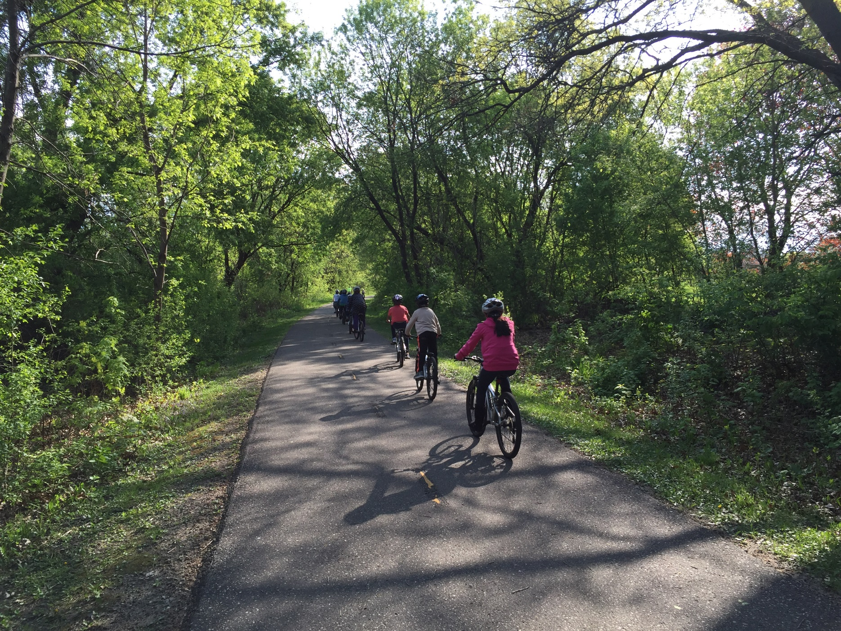
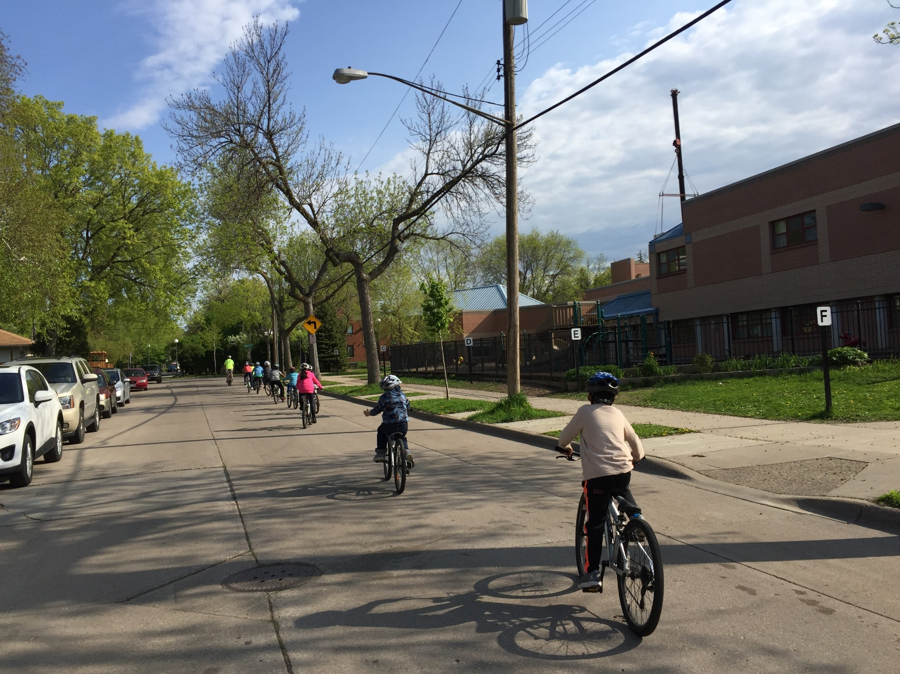
Avoid the school drop-off line and get outside.
mnsaferoutestoschool.org
Avoid the school drop-off line and get outside.
mnsaferoutestoschool.org

Slide 2
Dear [NAME OF SCHOOL] parent or guardian,
Don’t miss a chance to spend active, quality time with your child.
While it may seem like we save time by driving our children a short distance to school, we’re losing valuable moments spent biking with them.
Biking 1 mile takes only 10 minutes. Encourage your child to bike to school daily, especially on May 7th, Bike to School Day.
Find out more about Walk to School Day activities at [NAME OF SCHOOL] and volunteer opportunities by contacting [NAME] at [PHONE NUMBER] or email at [EMAIL].
Let’s all bike together!
P.S. We also have volunteer opportunities on Bike to School Day. Contact [NAME] for more information.
Dear [NAME OF SCHOOL] Parent or Guardian,
Don’t miss a chance to spend active, quality time with your child.
While it may seem like we save time by driving our children a short distance to school, we’re losing valuable moments spent biking with them.
Biking 1 mile takes only 10 minutes. Encourage your child to bike to school daily, especially on May 7th, Bike to School Day.
Find out more about Walk to School Day activities at [NAME OF SCHOOL] and volunteer opportunities by contacting [NAME] at [PHONE NUMBER] or email at [EMAIL].
Let’s all bike together!
P.S. We also have volunteer opportunities on Bike to School Day. Contact [NAME] for more information.

Slide 3
At [School Name], we bike to school!
mnsaferoutestoschool.org
At [School Name], we bike to school!
mnsaferoutestoschool.org

Slide 4
Dear [NAME OF SCHOOL] parent or guardian,
Get a fresh start this spring and enjoy the warmer weather by beginning a healthy new habit.
Walking or biking to school regularly provides health benefits and helps kids focus, not to mention avoiding the parent drop-off line.
On Bike to School Day, [X#] students at [NAME OF SCHOOL] biked to school! We encourage a culture of walking to school and safety for people walking and biking.
For more information about our walk and bike-to-school programs, such as the Walking School Bus or Bike Train, contact [NAME] at [PHONE NUMBER] or email at [EMAIL].
Let’s all walk together!
P.S. Bike to School Day is Wednesday, May 7th. Stay tuned for more information!
Dear [NAME OF SCHOOL] parent or guardian,
Get a fresh start this spring and enjoy the warmer weather by beginning a healthy new habit.
Walking or biking to school regularly provides health benefits and helps kids focus, not to mention avoiding the parent drop-off line.
On Bike to School Day, [X#] students at [NAME OF SCHOOL] biked to school! We encourage a culture of walking to school and safety for people walking and biking.
For more information about our walk and bike-to-school programs, such as the Walking School Bus or Bike Train, contact [NAME] at [PHONE NUMBER] or email at [EMAIL].
Let’s all walk together!
P.S. Bike to School Day is Wednesday, May 7th. Stay tuned for more information!

Slide 5
Roll into
spring
on
Bike to School Day!
mnsaferoutestoschool.org
Roll with
friends on
Bike to School Day!
May 7, 2025
mnsaferoutestoschool.org

Slide 6
Dear [NAME OF SCHOOL] parent or guardian,
May 8th is Bike to School Day, an annual international event encouraging children to bike to school and participate in various activities. As you know, your home is located so close to [NAME OF SCHOOL] that your children may not have bus service.
Living close to school means that your child has the opportunity to walk or bike to school regularly, which provides many benefits. Biking 1 mile only takes 10 minutes. Encourage your child to bike to school daily, especially on May 7th.
Find out more about Bike to School Day activities at [NAME OF SCHOOL] and volunteer opportunities by contacting [NAME] at [PHONE NUMBER] or email at [EMAIL].
Let’s all bike together!
Dear [NAME OF SCHOOL] parent or guardian,
May 8th is Bike to School Day, an annual international event encouraging children to bike to school and participate in various activities. As you know, your home is located so close to [NAME OF SCHOOL] that your children may not have bus service.
Living close to school means that your child has the opportunity to walk or bike to school regularly, which provides many benefits. Biking 1 mile only takes 10 minutes. Encourage your child to bike to school daily, especially on May 7th.
Find out more about Bike to School Day activities at [NAME OF SCHOOL] and volunteer opportunities by contacting [NAME] at [PHONE NUMBER] or email at [EMAIL].
Let’s all bike together!

Slide 7
You’re in the bike and walk zone!
mnsaferoutestoschool.org
You’re in the bike and walk zone!
mnsaferoutestoschool.org

Slide 8
Dear [NAME OF SCHOOL] parent or guardian,
May 8th is Bike to School Day, an annual international event encouraging children to bike to school and participate in various activities. As you know, your home is located so close to [NAME OF SCHOOL] that your children may not have bus service.
Living close to school means that your child has the opportunity to walk or bike to school regularly, which provides many benefits. Biking 1 mile only takes 10 minutes. Encourage your child to bike to school daily, especially on May 7th.
Find out more about Bike to School Day activities at [NAME OF SCHOOL] and volunteer opportunities by contacting [NAME] at [PHONE NUMBER] or email at [EMAIL].
Let’s all bike together!
Dear [NAME OF SCHOOL] parent or guardian,
May 8th is Bike to School Day, an annual international event encouraging children to bike to school and participate in various activities. As you know, your home is located so close to [NAME OF SCHOOL] that your children may not have bus service.
Living close to school means that your child has the opportunity to walk or bike to school regularly, which provides many benefits. Biking 1 mile only takes 10 minutes. Encourage your child to bike to school daily, especially on May 7th.
Find out more about Bike to School Day activities at [NAME OF SCHOOL] and volunteer opportunities by contacting [NAME] at [PHONE NUMBER] or email at [EMAIL].
Let’s all bike together!

