Slide 1
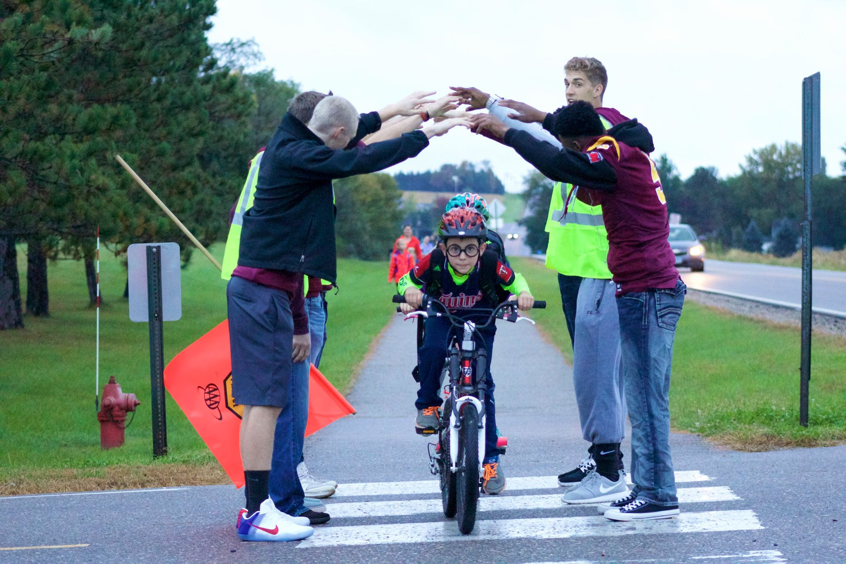
^{Bike to School Day}
May 7th
Ditch the Drive and Join the Ride!

