Slide 1
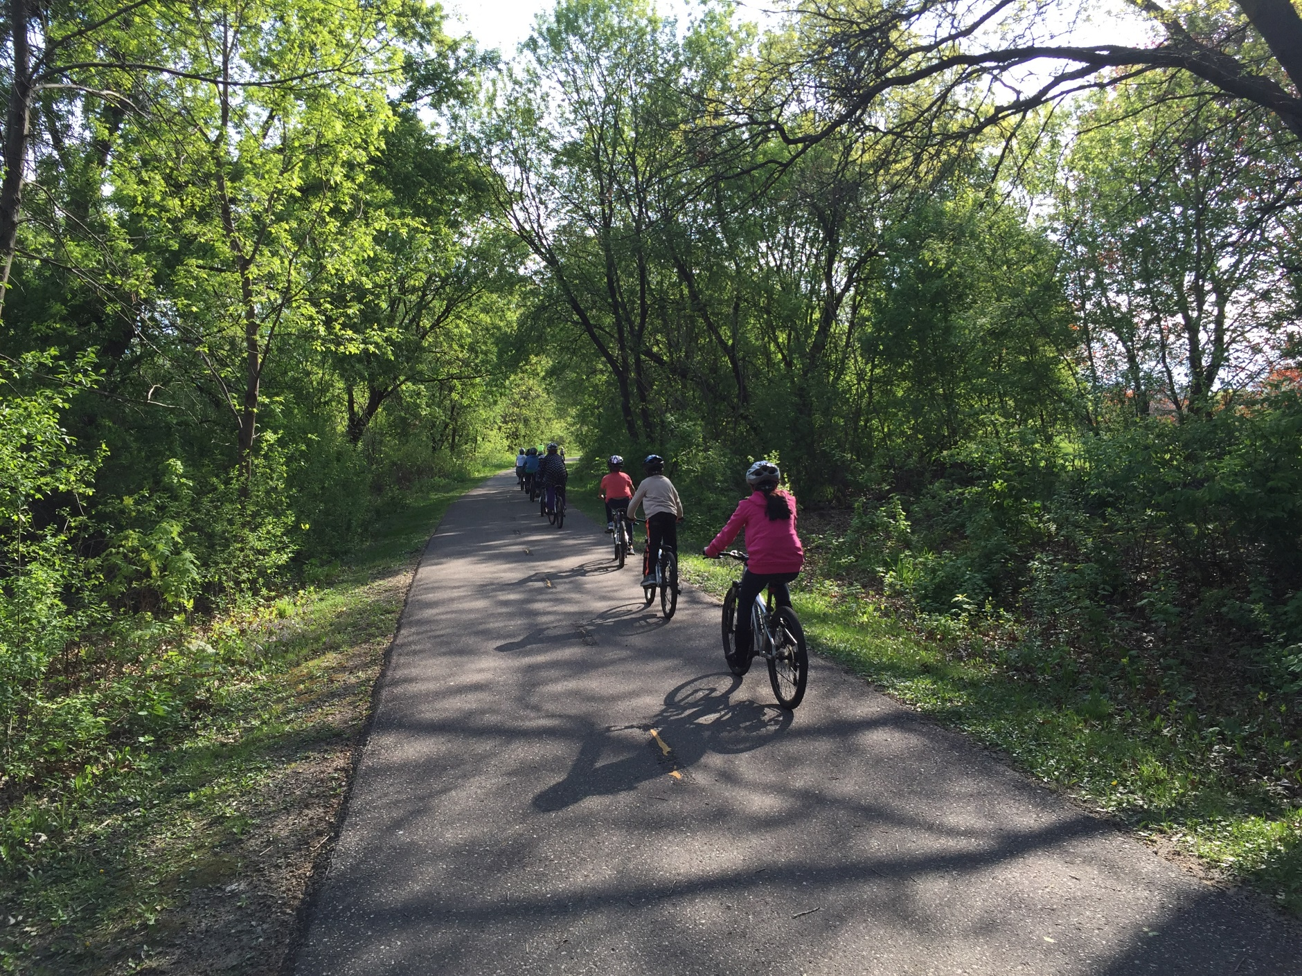
Parents and Guardians,
We need volunteers.
May 7th
2025
^{Bike to School Day}
^{Volunteer to:}
^{Lead a bike train}
Host a check point for bike trains
Provide refreshments at the school
Provide prizes for participating students
Encourage your child and their friends to participate
Not sure how to help? We have guides to get you started. If you (or someone you know) can help, please contact:
Learn more about Minnesota Safe Routes to School: www.mnsaferoutestoschool.org

