Slide 1
Make a New Year’s resolution to walk to school!
mnsaferoutestoschool.org
Make a New Year’s resolution to walk to school!
mnsaferoutestoschool.org

Slide 2
Dear [NAME OF SCHOOL] parent/guardian:
Get a fresh start to the new year by starting a healthy new habit with your kids!
Wednesday, February 5th is Winter Walk to School Day, an annual international event that encourages children to walk to school.
Walking or biking to school regularly provides health benefits and helps kids focus at school.
Find out more about Winter Walk to School Day activities at [NAME OF SCHOOL] by contacting [NAME] at [PHONE NUMBER] or email at [EMAIL].
Let’s all walk together!
P.S. We also have volunteer opportunities on Winter Walk to School Day. Contact [NAME] for more information.
Dear [NAME OF SCHOOL] parent/guardian:
Get a fresh start to the new year by starting a healthy new habit with your kids!
Wednesday, February 5th is Winter Walk to School Day, an annual international event that encourages children to walk to school.
Walking or biking to school regularly provides health benefits and helps kids focus at school.
Find out more about Winter Walk to School Day activities at [NAME OF SCHOOL] by contacting [NAME] at [PHONE NUMBER] or email at [EMAIL].
Let’s all walk together!
P.S. We also have volunteer opportunities on Winter Walk to School Day. Contact [NAME] for more information.

Slide 3
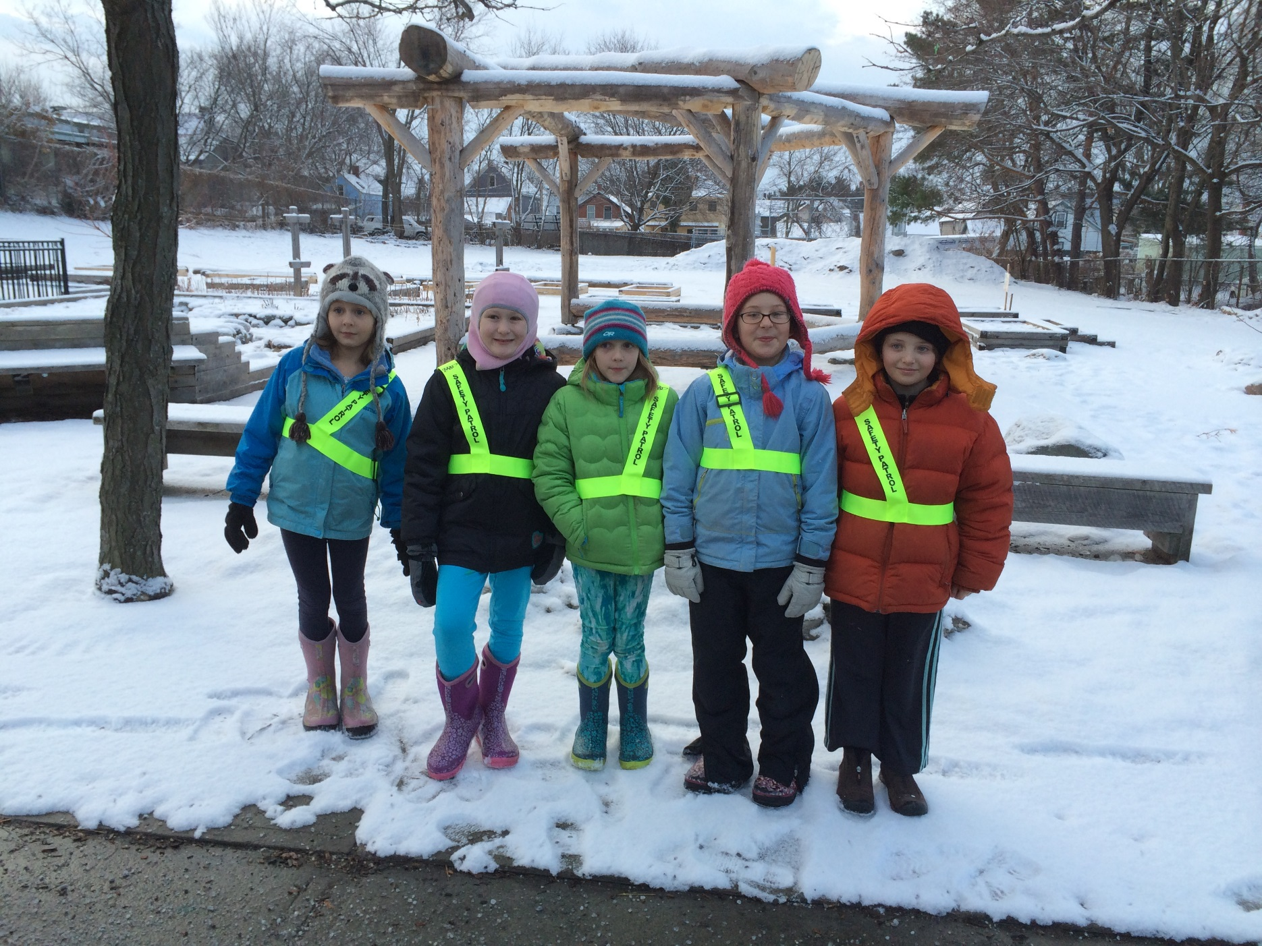
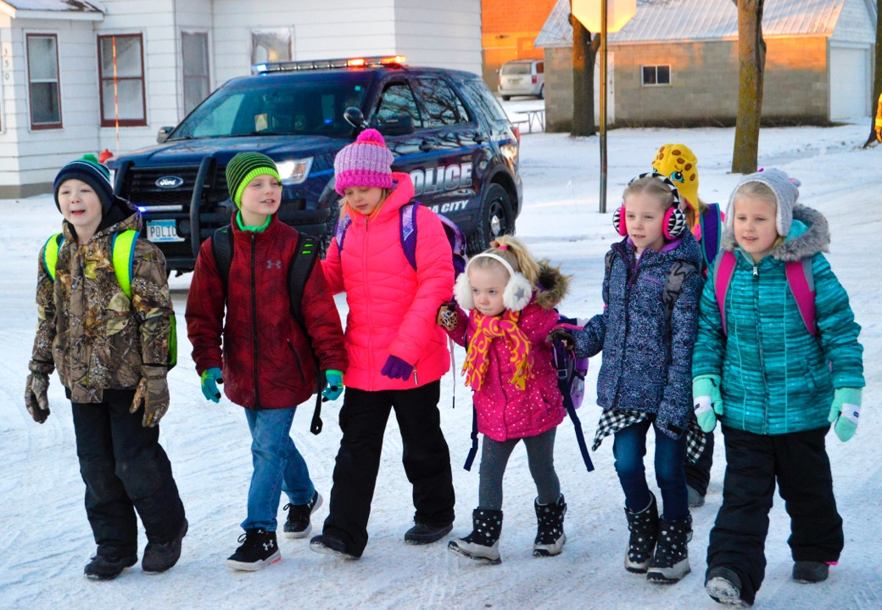
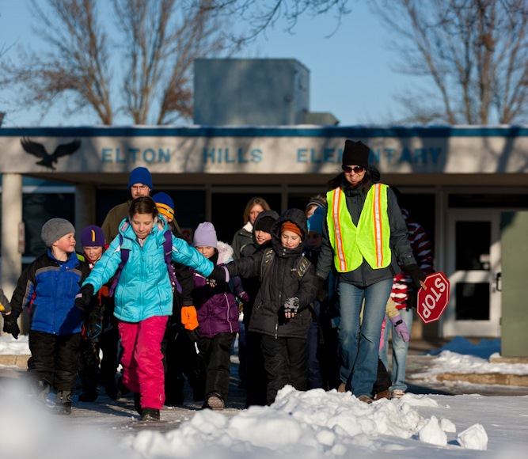
Make a New Year’s resolution to walk to school!
mnsaferoutestoschool.org
Make a New Year’s resolution to walk to school!
mnsaferoutestoschool.org

Slide 4
Dear [NAME OF SCHOOL] parent/guardian:
Get a fresh start to the new year by starting a healthy new habit with your kids!
Wednesday, February 5th is Winter Walk to School Day, an annual international event that encourages children to walk to school.
Walking or biking to school regularly provides health benefits and helps kids focus at school.
Find out more about Winter Walk to School Day activities at [NAME OF SCHOOL] by contacting [NAME] at [PHONE NUMBER] or email at [EMAIL].
Let’s all walk together!
P.S. We also have volunteer opportunities on Winter Walk to School Day. Contact [NAME] for more information.
Dear [NAME OF SCHOOL] parent/guardian:
Get a fresh start to the new year by starting a healthy new habit with your kids!
Wednesday, February 5th is Winter Walk to School Day, an annual international event that encourages children to walk to school.
Walking or biking to school regularly provides health benefits and helps kids focus at school.
Find out more about Winter Walk to School Day activities at [NAME OF SCHOOL] by contacting [NAME] at [PHONE NUMBER] or email at [EMAIL].
Let’s all walk together!
P.S. We also have volunteer opportunities on Winter Walk to School Day. Contact [NAME] for more information.

