Slide 1
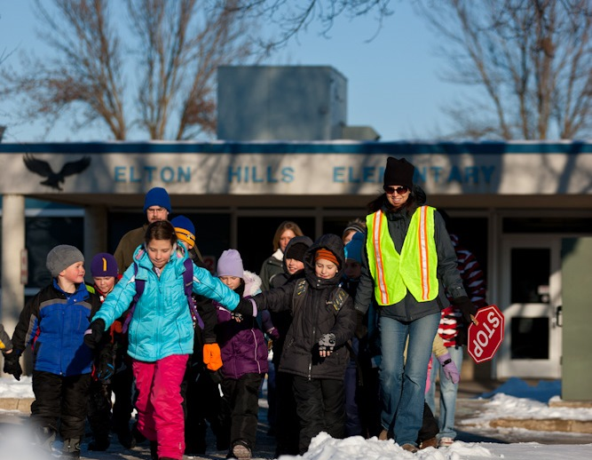
Pib lub Xyoo Tshiab nrog qhov taug kev yam zoo siab lug!
Hnub Taug Kev Thaum Caij Ntuj No: Ob hlis 5
Peb xav tau cov niam txiv tuaj pab dawb rau Hnub Taug Kev Mus Kawm Ntawv ntawm [Name of School]!
Ua tus ntaus thawj coj cov menyuam taug kev mus kawm ntawv
Sawv ntawm ib qho chawj kuaj cov menyuam taug kev mus kawm ntawv
Muab dej haus thiab khoom plig pem tsev kawm ntawv
Txhaub cov menyuam thiab lawv cov phooj ywg tuaj koom!
Npaj tuaj pab? Sib tiv tauj!
Contact [role] [First name] [Last name]
[Phone number] | [E-mail address]
Learn more about Minnesota Safe Routes to School: www.mnsaferoutestoschool.org

