Slide 1
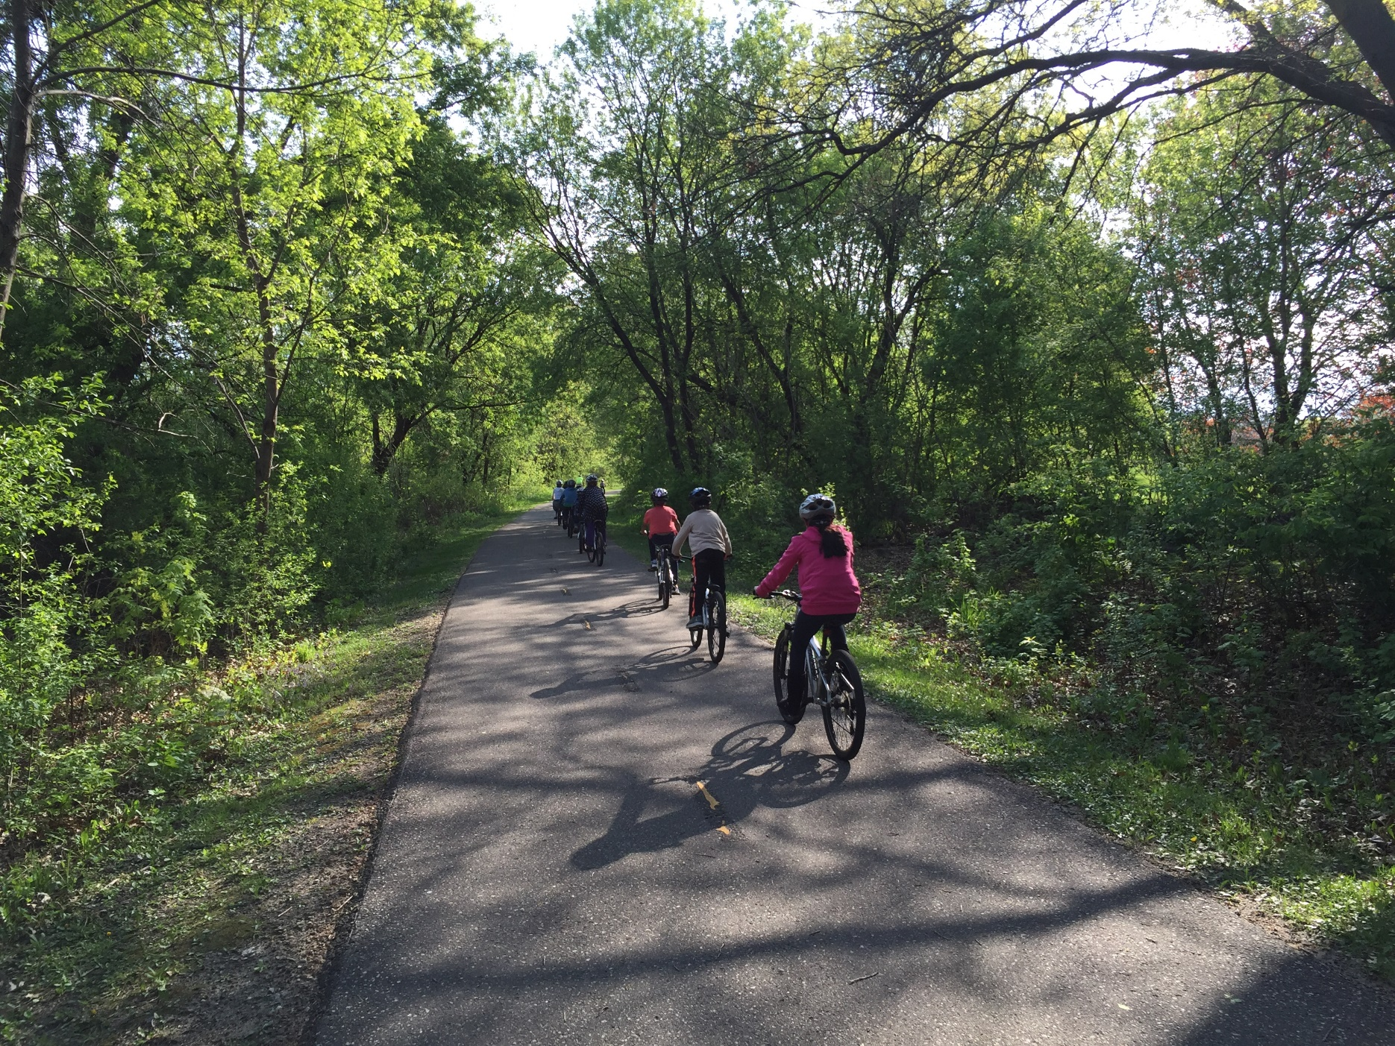
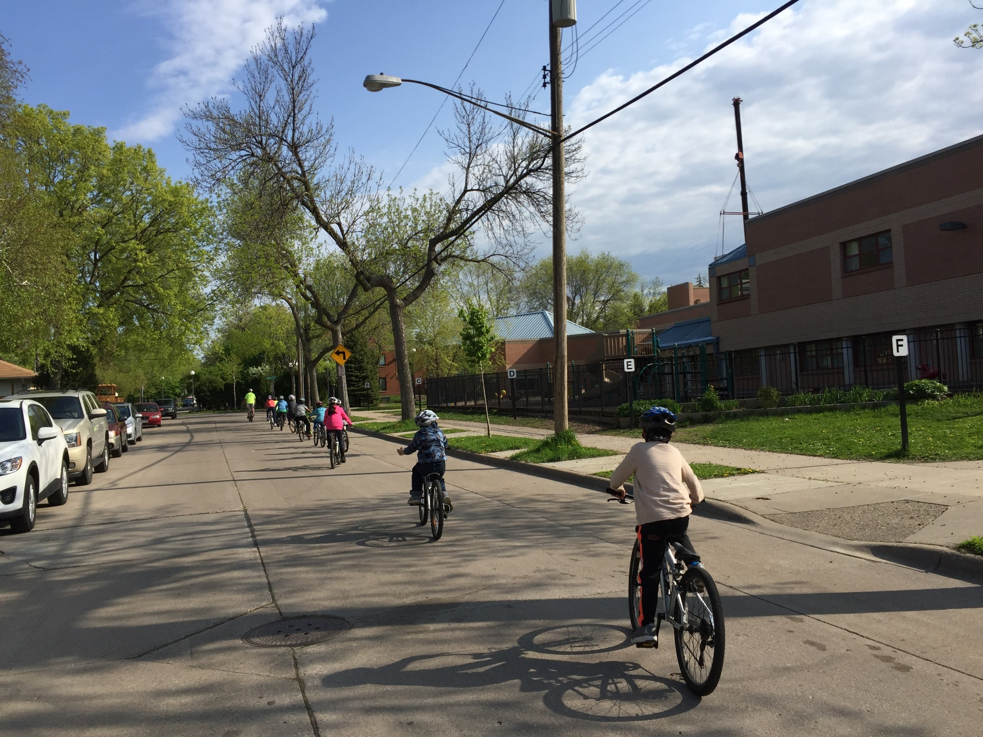
Tsis txhob siv koj lub caij thaum sawv ntxov tos ntawm txoj kab thauj neeg tuaj tso peb tsev kawm ntawv – tawm mus nraum zoov!
mnsaferoutestoschool.org
Tsis txhob siv koj lub caij thaum sawv ntxov tos ntawm txoj kab thauj neeg tuaj tso peb tsev kawm ntawv – tawm mus nraum zoov!
mnsaferoutestoschool.org

Slide 2
Nyob zoo [NAME OF SCHOOL] cov niam txiv/cov saib xyuas,
Tsis txhob plam lub hwv tsam siv ib qho sij hawm zoo ua tej yam nrog koj tus menyuam.
Thaum xav tias ntxim li peb tsis nkim sij hawm vim peb tsav tsheb thauj peb cov menyuam mus kawm ntawv es nyob tsis deb, tabsis peb kuj xiam lub caij muaj nuj nqis nrog peb tus menyuam cai luv thij uake.
Caij luv thij 1 mais tsuas siv sij hawm ntev li 10 nasthis xwb, thiab caij luv thij 2 mais tsuas siv sij hawm ntev li 20 nasthis xwb. Txhaub koj tus menyuam koj nws caij luv thij mus kawm ntawv txhua hnub, tshwj xeeb yog thaum lub Tsib Hlis hnub tim 8th, Hnub caij Luv Thij Mus Kawm Ntawv!
Kom paub ntau dua txog Hnub Taug Kev Thaum Caij Ntuj No [NAME OF SCHOOL] es yog tiv tauj [NAME] at [PHONE NUMBER] los yog tus email ntawm [EMAIL].
Los sawv daws caij luv thij uake!
P.S. Peb kuj muaj cov hwv tsam kom tuaj pab dawb tau rau hnub Taug Kev Thaum Caij Ntuj No Tiv tauj [NAME] kom paub ntau dua.
Nyob zoo [NAME OF SCHOOL] cov niam txiv/cov saib xyuas,
Tsis txhob plam lub hwv tsam siv ib qho sij hawm zoo ua tej yam nrog koj tus menyuam.
Thaum xav tias ntxim li peb tsis nkim sij hawm vim peb tsav tsheb thauj peb cov menyuam mus kawm ntawv es nyob tsis deb, tabsis peb kuj xiam lub caij muaj nuj nqis nrog peb tus menyuam cai luv thij uake.
Caij luv thij 1 mais tsuas siv sij hawm ntev li 10 nasthis xwb, thiab caij luv thij 2 mais tsuas siv sij hawm ntev li 20 nasthis xwb. Txhaub koj tus menyuam koj nws caij luv thij mus kawm ntawv txhua hnub, tshwj xeeb yog thaum lub Tsib Hlis hnub tim 8th, Hnub caij Luv Thij Mus Kawm Ntawv!
Kom paub ntau dua txog Hnub Taug Kev Thaum Caij Ntuj No [NAME OF SCHOOL] es yog tiv tauj [NAME] at [PHONE NUMBER] los yog tus email ntawm [EMAIL].
Los sawv daws caij luv thij uake!
P.S. Peb kuj muaj cov hwv tsam kom tuaj pab dawb tau rau hnub Taug Kev Thaum Caij Ntuj No Tiv tauj [NAME] kom paub ntau dua.

Slide 3
Ntawm [School Name], peb caij luv thij mus kawm ntawv!
mnsaferoutestoschool.org
Ntawm [School Name], peb caij luv thij mus kawm ntawv!
mnsaferoutestoschool.org

Slide 4
Nyob zoo [NAME OF SCHOOL] cov niam txiv/cov saib xyuas,
Pib ib qho tshiab thaum lub caij nplooj ntoos hlav thiab tawm mus lam cua sov es yog pib tej yam ua tshiab kom muaj kev noj qab nyob zoo rau lub cev.
Taug kiv los yog caij tsheb kauj vam tas mus li ua rau muaj txiaj ntsim zoo rau kev noj qab nyob zoo rau lub cev thiab pab koj tus menyuam kom kawm mloog lus thiab kawm tau ntawv zoo, thiab kuj zam tau qhov es ua tsheb ua thib tos hauv tsheb thaum xa thiab tuaj tos menyuam!
Ntawm hnub es Caij Luv Thij Tuaj Kawm ntawv, [X#] cov tub ntxhais nyob [NAME OF SCHOOL] caij luv thij tuaj kawm ntawv! Peb txhaub kom muaj neeg taug kev mus kawm ntawv thiab kom muaj kev puaj phais rau tib neeg taug kev thiab caij luv thij.
Kom paub ntau dua txog peb qhov taug kev thiab caij luv thij mus kawm ntawv xws li Taug Kev Mus Ntawv Ua Ke os yog Caij Luv Thij Ua Ib Kab Sab, tiv tauj[NAME] ntawm [PHONE NUMBER] los yog email rau[EMAIL].
Los sawv daws taug kev uake!
P.S. Hnub caij luv thij mus kawm ntawv yog hnub Wednesday, Lub Tsib Hlis tim 8th mloog ntsoov, peb mam qhia dua ntxiv.
Nyob zoo [NAME OF SCHOOL] cov niam txiv/cov saib xyuas,
Pib ib qho tshiab thaum lub caij nplooj ntoos hlav thiab tawm mus lam cua sov es yog pib tej yam ua tshiab kom muaj kev noj qab nyob zoo rau lub cev.
Taug kiv los yog caij tsheb kauj vam tas mus li ua rau muaj txiaj ntsim zoo rau kev noj qab nyob zoo rau lub cev thiab pab koj tus menyuam kom kawm mloog lus thiab kawm tau ntawv zoo, thiab kuj zam tau qhov es ua tsheb ua thib tos hauv tsheb thaum xa thiab tuaj tos menyuam!
Ntawm hnub es Caij Luv Thij Tuaj Kawm ntawv, [X#] cov tub ntxhais nyob [NAME OF SCHOOL] caij luv thij tuaj kawm ntawv! Peb txhaub kom muaj neeg taug kev mus kawm ntawv thiab kom muaj kev puaj phais rau tib neeg taug kev thiab caij luv thij.
Kom paub ntau dua txog peb qhov taug kev thiab caij luv thij mus kawm ntawv xws li Taug Kev Mus Ntawv Ua Ke os yog Caij Luv Thij Ua Ib Kab Sab, tiv tauj[NAME] ntawm [PHONE NUMBER] los yog email rau[EMAIL].
Los sawv daws taug kev uake!
P.S. Hnub caij luv thij mus kawm ntawv yog hnub Wednesday, Lub Tsib Hlis tim 8th mloog ntsoov, peb mam qhia dua ntxiv.

Slide 5
Caij luv thij thaum txog caij nplooj ntoos hlav rau hnub Caij Luv Thij Mus Kawm Ntawv!
mnsaferoutestoschool.org
Caij luv thij nrog cov phooj ywg
rau hnub Caij Luv Thij Mus Kawm Ntawv!
mnsaferoutestoschool.org

Slide 6
Nyob zoo [NAME OF SCHOOL] cov niam txiv/cov saib xyuas,
[Lub Tsib Hlis tim 8th] yog hnub Caij Luv Thij Mus Kawm ntawv, yog lub koom txhoos ib xyoos muaj ib zaug es txhaub kom cov menyuam caij luv thij mus kawm ntawv thiab koom nrog ntau yam kev uasi, Koj twb paub lawm, koj lub tsev nyob ze heev rau [NAME OF SCHOOL] es koj cov menyuam tsis tau npav caij. Qhov no yog ib qho zoo!
Nyob ze heev rau lub tsev kawm ntawv txhais tias koj tus menyuam muaj lub hwv tsam tau kev los yog caij luv thij mus kawm ntawv tas mus li, es yeej muaj ntau yam txiaj ntsim rau nws. Caij luv thij 1 mais tsuas siv sij hawm ntev li 10 nasthis xwb, thiab caij luv thij 2 mais tsuas siv sij hawm ntev li 20 nasthis xwb. Tshwj xeeb yog thaum [May 8th]!
Kom paub ntau dua txog Hnub Caij Luv Thij Mus Kawm Ntawv ntawm [NAME OF SCHOOL] thiab cov hwv tsam tuaj pab sij hawm dawb es yog tiv tauj rau [NAME] ntawm [PHONE NUMBER] los yog email rau [EMAIL].
Los sawv daws caij luv thij uake!
Nyob zoo [NAME OF SCHOOL] cov niam txiv/cov saib xyuas,
[Lub Tsib Hlis tim 8th] yog hnub Caij Luv Thij Mus Kawm ntawv, yog lub koom txhoos ib xyoos muaj ib zaug es txhaub kom cov menyuam caij luv thij mus kawm ntawv thiab koom nrog ntau yam kev uasi, Koj twb paub lawm, koj lub tsev nyob ze heev rau [NAME OF SCHOOL] es koj cov menyuam tsis tau npav caij. Qhov no yog ib qho zoo!
Nyob ze heev rau lub tsev kawm ntawv txhais tias koj tus menyuam muaj lub hwv tsam tau kev los yog caij luv thij mus kawm ntawv tas mus li, es yeej muaj ntau yam txiaj ntsim rau nws. Caij luv thij 1 mais tsuas siv sij hawm ntev li 10 nasthis xwb, thiab caij luv thij 2 mais tsuas siv sij hawm ntev li 20 nasthis xwb. Tshwj xeeb yog thaum [May 8th]!
Kom paub ntau dua txog Hnub Caij Luv Thij Mus Kawm Ntawv ntawm [NAME OF SCHOOL] thiab cov hwv tsam tuaj pab sij hawm dawb es yog tiv tauj rau [NAME] ntawm [PHONE NUMBER] los yog email rau [EMAIL].
Los sawv daws caij luv thij uake!

Slide 7
Koj nyob hauv txoj kab caij lub thij & taug kev
mnsaferoutestoschool.org
Koj nyob hauv txoj kab caij lub thij thiab taug kev
mnsaferoutestoschool.org

Slide 8
Nyob zoo [NAME OF SCHOOL] cov niam txiv/cov saib xyuas,
[Lub Tsib Hlis tim 8th] yog hnub Caij Luv Thij Mus Kawm ntawv, yog lub koom txhoos ib xyoos muaj ib zaug es txhaub kom cov menyuam caij luv thij mus kawm ntawv thiab koom nrog ntau yam kev uasi, Koj twb paub lawm, koj lub tsev nyob ze heev rau [NAME OF SCHOOL] es koj cov menyuam tsis tau npav caij. Qhov no yog ib qho zoo!
Nyob ze heev rau lub tsev kawm ntawv txhais tias koj tus menyuam muaj lub hwv tsam tau kev los yog caij luv thij mus kawm ntawv tas mus li, es yeej muaj ntau yam txiaj ntsim rau nws. Caij luv thij 1 mais tsuas siv sij hawm ntev li 10 nasthis xwb, thiab caij luv thij 2 mais tsuas siv sij hawm ntev li 20 nasthis xwb. Tshwj xeeb yog thaum [May 8th]!
Kom paub ntau dua txog Hnub Caij Luv Thij Mus Kawm Ntawv ntawm [NAME OF SCHOOL] thiab cov hwv tsam tuaj pab sij hawm dawb es yog tiv tauj rau [NAME] ntawm [PHONE NUMBER] los yog email rau [EMAIL].
Los sawv daws caij luv thij uake!
Nyob zoo [NAME OF SCHOOL] cov niam txiv/cov saib xyuas,
[Lub Tsib Hlis tim 8th] yog hnub Caij Luv Thij Mus Kawm ntawv, yog lub koom txhoos ib xyoos muaj ib zaug es txhaub kom cov menyuam caij luv thij mus kawm ntawv thiab koom nrog ntau yam kev uasi, Koj twb paub lawm, koj lub tsev nyob ze heev rau [NAME OF SCHOOL] es koj cov menyuam tsis tau npav caij. Qhov no yog ib qho zoo!
Nyob ze heev rau lub tsev kawm ntawv txhais tias koj tus menyuam muaj lub hwv tsam tau kev los yog caij luv thij mus kawm ntawv tas mus li, es yeej muaj ntau yam txiaj ntsim rau nws. Caij luv thij 1 mais tsuas siv sij hawm ntev li 10 nasthis xwb, thiab caij luv thij 2 mais tsuas siv sij hawm ntev li 20 nasthis xwb. Tshwj xeeb yog thaum [May 8th]!
Kom paub ntau dua txog Hnub Caij Luv Thij Mus Kawm Ntawv ntawm [NAME OF SCHOOL] thiab cov hwv tsam tuaj pab sij hawm dawb es yog tiv tauj rau [NAME] ntawm [PHONE NUMBER] los yog email rau [EMAIL].
Los sawv daws caij luv thij uake!

