Slide 1
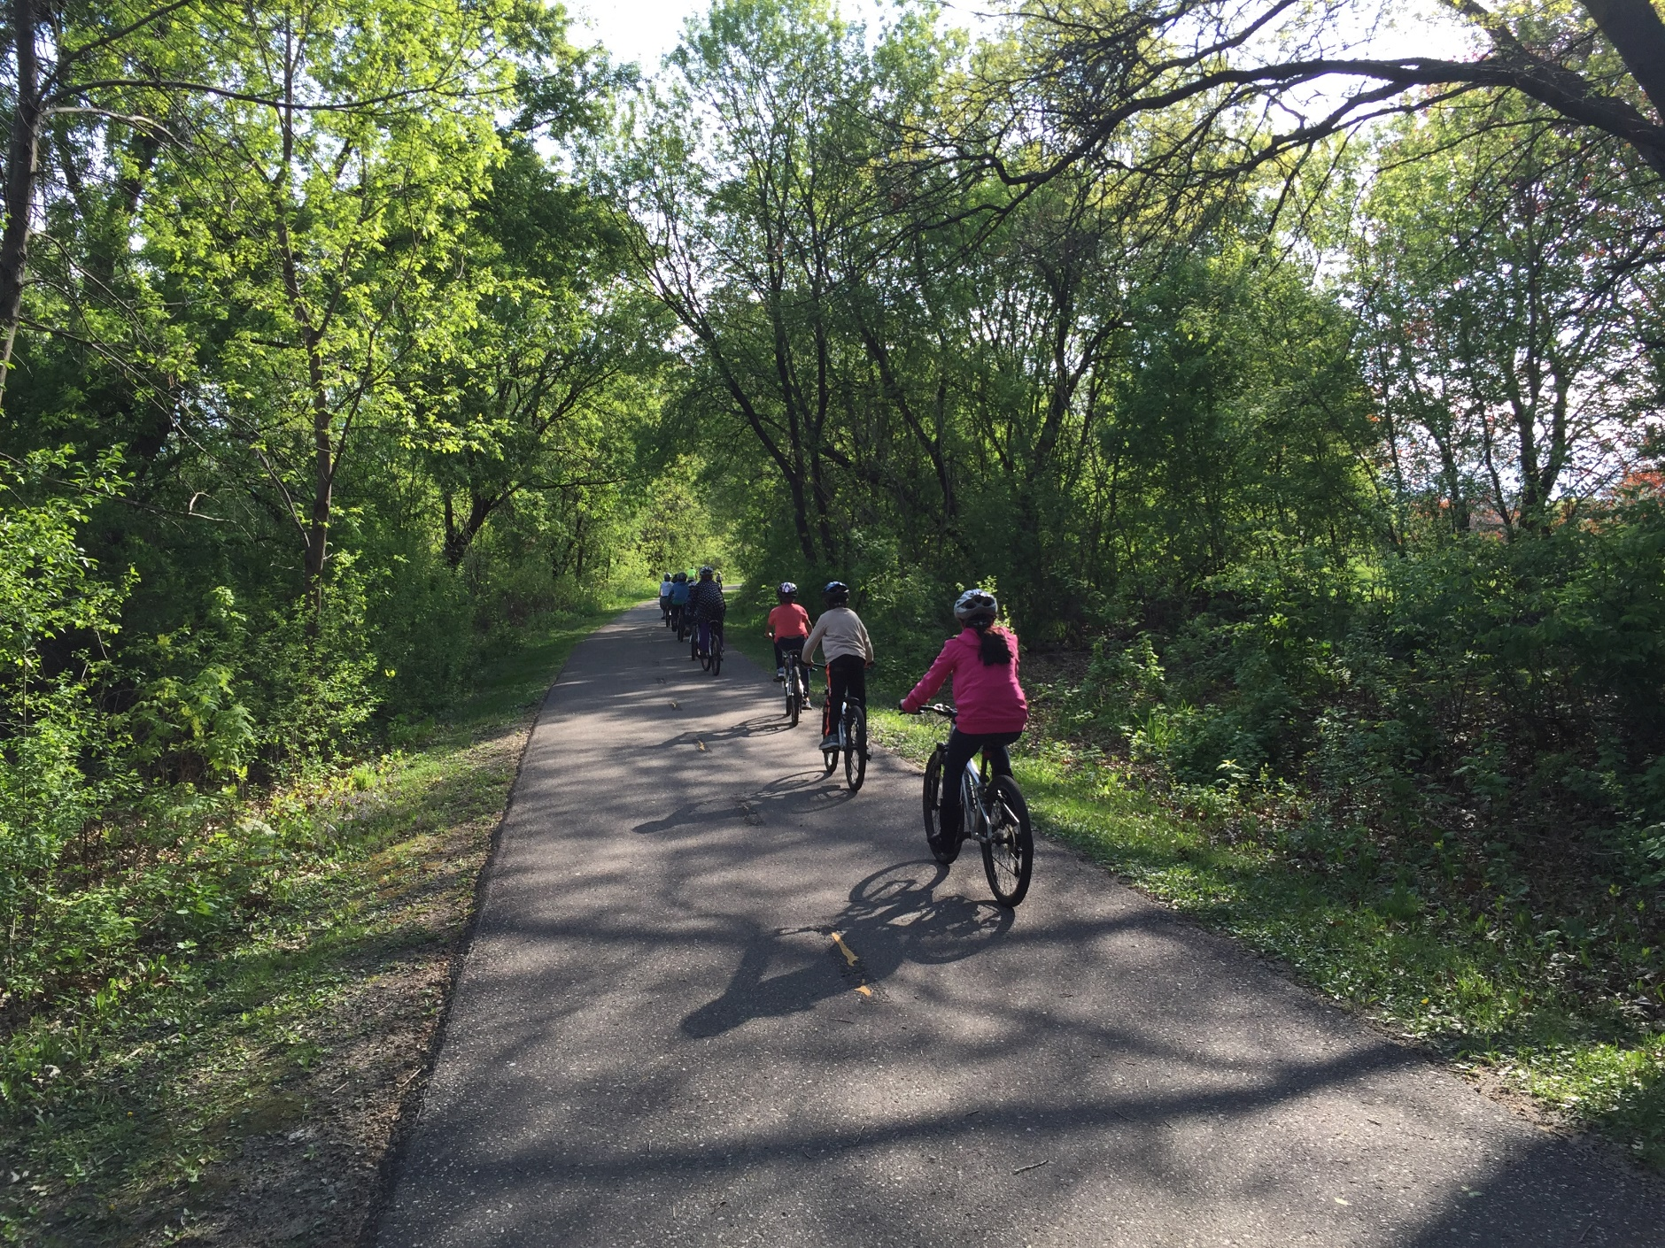
Cov Niam Txiv & Cov Saib Xyuas,
Peb xav tau neeg tuaj pab!
Hnub Caij Luv Thij mus kawm ntawv!
Peb xav tau neeg tuaj pab rau Hnub Caij Luv Thij Mus Kawm Ntawv
[Name of School]
Tsib Hlis hnub tim 8th, 2023
^{Koj pab tau li cas}
Ua tus coj kev caij luv thij ua ntej
Sawv ntawm qhov chaw saib cov neeg caij luv thij
Muab dej rau haus pem tsev kawm ntawv
Muab phaj tshab rau cov tub ntxhais es koom
Txhaub koj tus menyuam thiab nws cov phooj ywg kom tuaj khoom
Tsis paub tias yuav pab li cas? Peb muaj cov ntawv qhia kom koj paub pib!
Yog koj (los yog ib tug neeg koj paub) yeej pab tau, thov tiv tauj:
[Name]
[Email] [Phone Number]
Kawm paub ntxiv txog Minnesota Safe Routes to School: www.mnsaferoutestoschool.org

