Slide 1
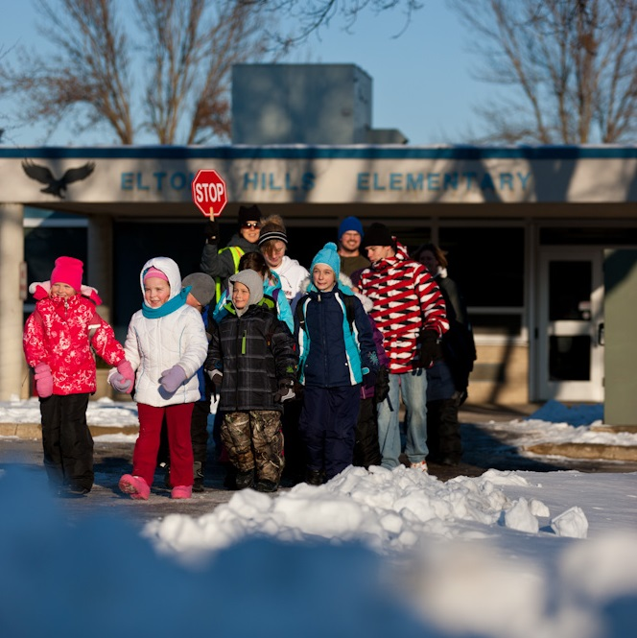
Tsis Txhob Nkaum! Tuaj koom!
Hnub Taug Kev Thaum Caij Ntuj No yog lub Ob Hlis 7
Kom paub ntau dua, saib hauv: www.mnsaferoutestoschool.org

Slide 2
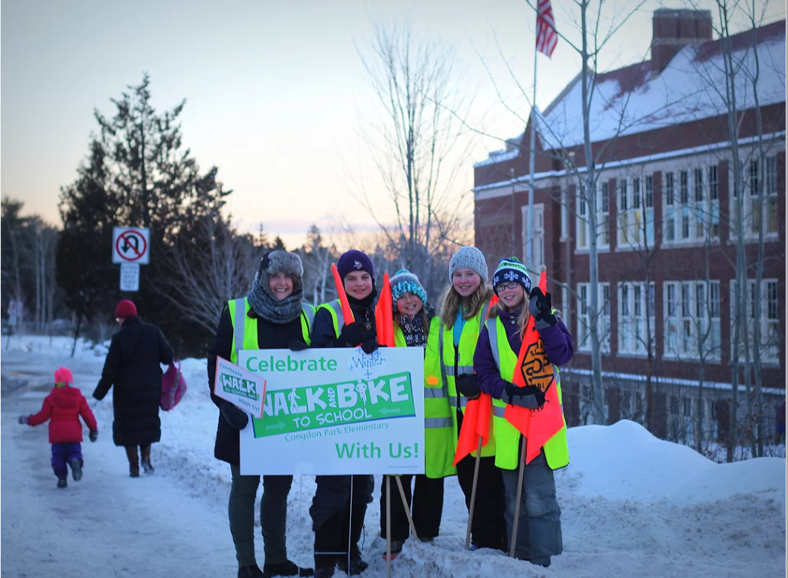
Tsis Txhob Nkaum! Tuaj koom!
Hnub Taug Kev Thaum Caij Ntuj No yog lub Ob Hlis 7
Kom paub ntau dua, saib hauv: www.mnsaferoutestoschool.org

Slide 3
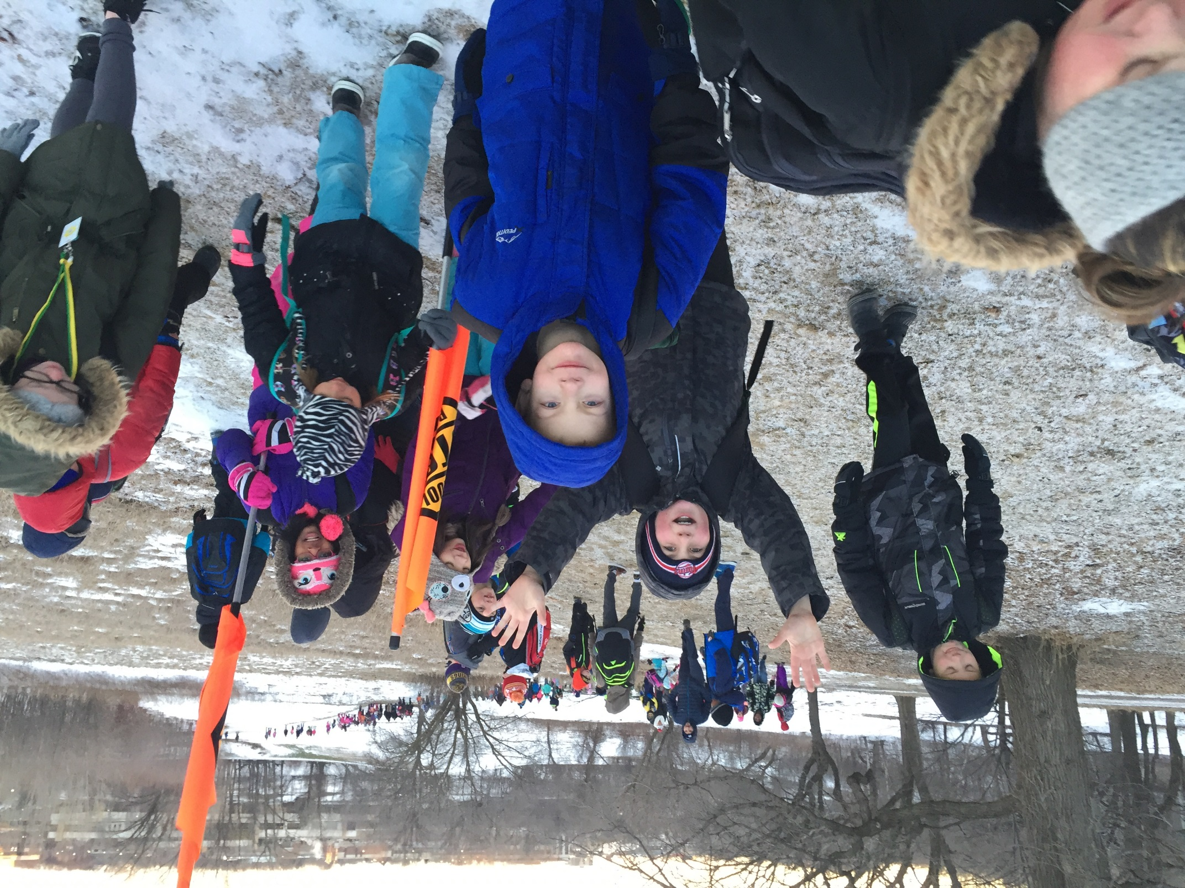
Koom nrog pawg neeg taug kev thaum caij ntuj no!
Hnub Taug Kev Thaum Caij Ntuj No – Ob hlis 7
Kom paub ntau dua, saib hauv: www.mnsaferoutestoschool.org

Slide 4
Maj mam tau kev, kov cov daus uasi!
Koom nrog peb rau Hnub Taug Kev Thaum Caij Ntuj No rau lub Ob hlis 7
Walk to School Day!
October 4, 2017
Winter Walk Day is February 2nd!
For more information, visit: www.mnsaferoutestoschool.org

