Slide 1
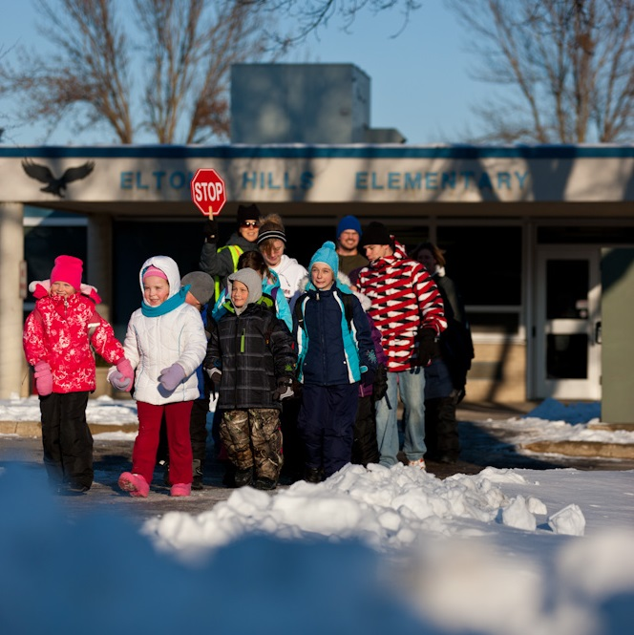
Don’t Hibernate, Participate!
Winter Walk Day is Feb. 7th!
For more information, visit: www.mnsaferoutestoschool.org

Slide 2
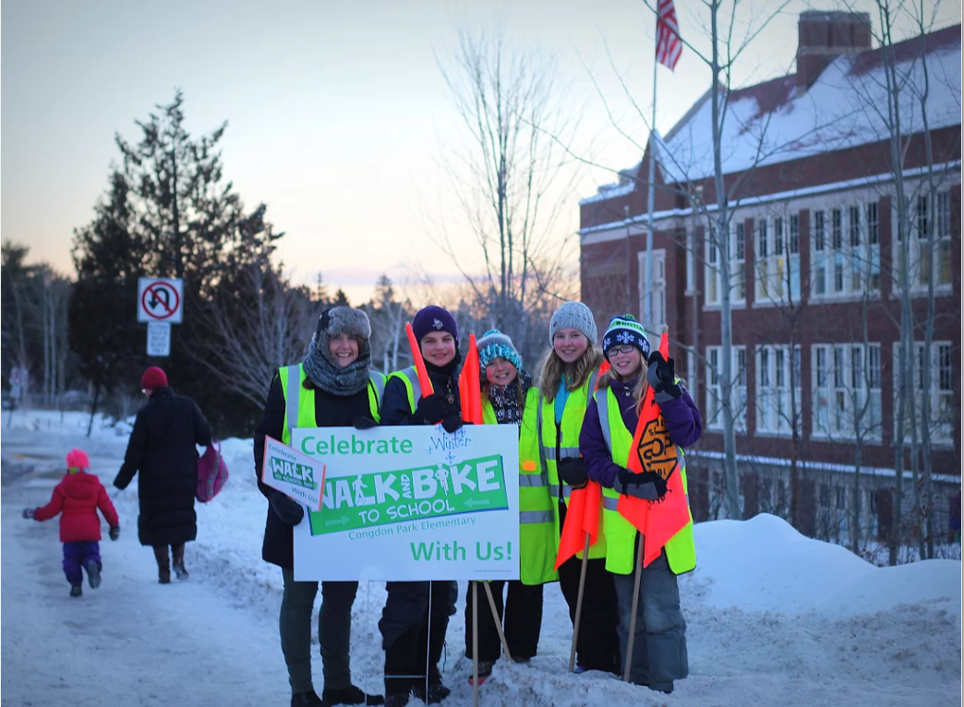
Don’t Hibernate, Participate!
Winter Walk Day is Feb. 7th!
For more information, visit: www.mnsaferoutestoschool.org

Slide 3
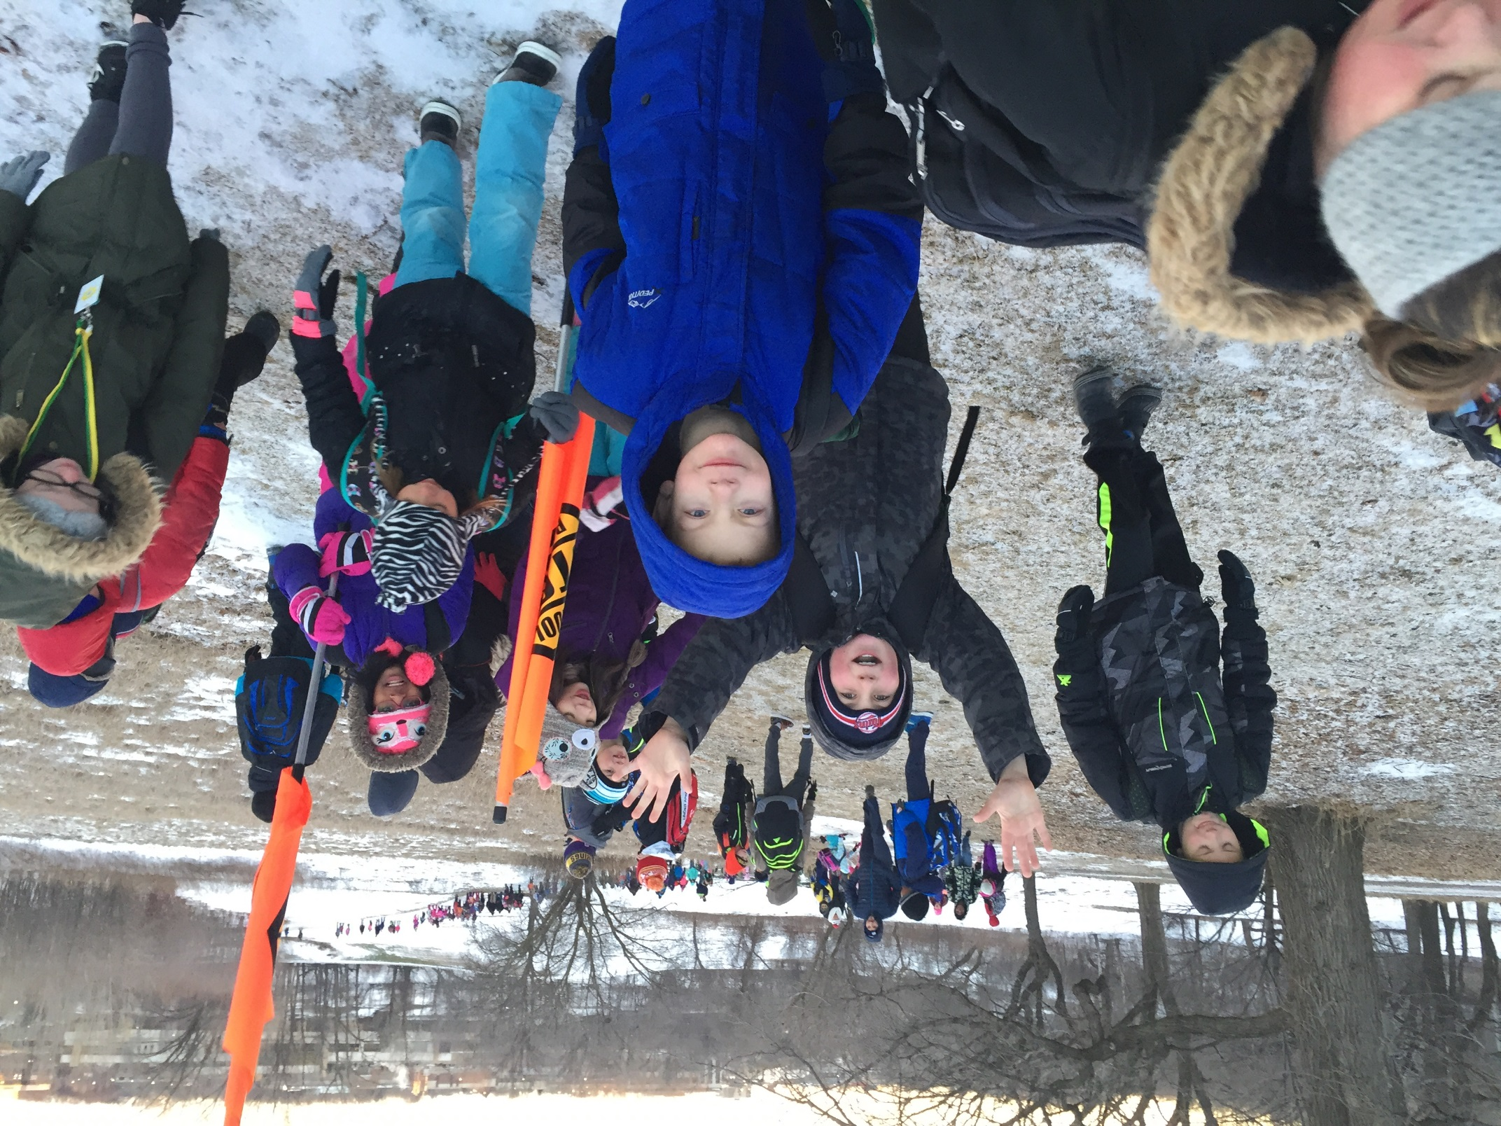
Join the Winter Walk Club!
Walk to School on Winter Walk Day – Feb. 7th
For more information, visit: www.mnsaferoutestoschool.org

Slide 4
Go Slow, Enjoy the Snow!
Join us for Winter Walk to School Day on February 7th
Walk to School Day!
October 4, 2017
Winter Walk Day is February 2nd!
For more information, visit: www.mnsaferoutestoschool.org

