Slide 1
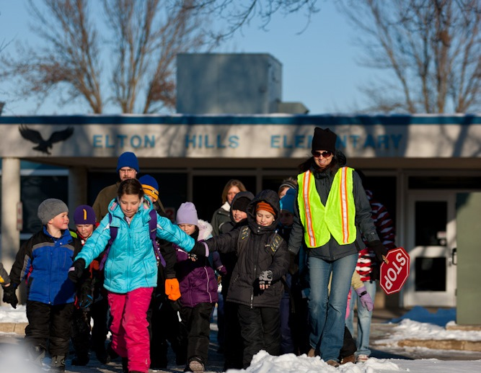
Start the New Year with walking cheer for a healthy habit!
Winter Walk Day: February 7, 2024
We need parent volunteers for Walk to School Day at [Name of School]!
Lead a walking school bus
Host a check point for walking school buses
Provide refreshments & prizes at the school
Encourage your child and their friends to participate!
Ready to help? Get in touch!
Contact [role] [First name] [Last name]
[Phone number] | [E-mail address]
Learn more about Minnesota Safe Routes to School: www.mnsaferoutestoschool.org

