Slide 1
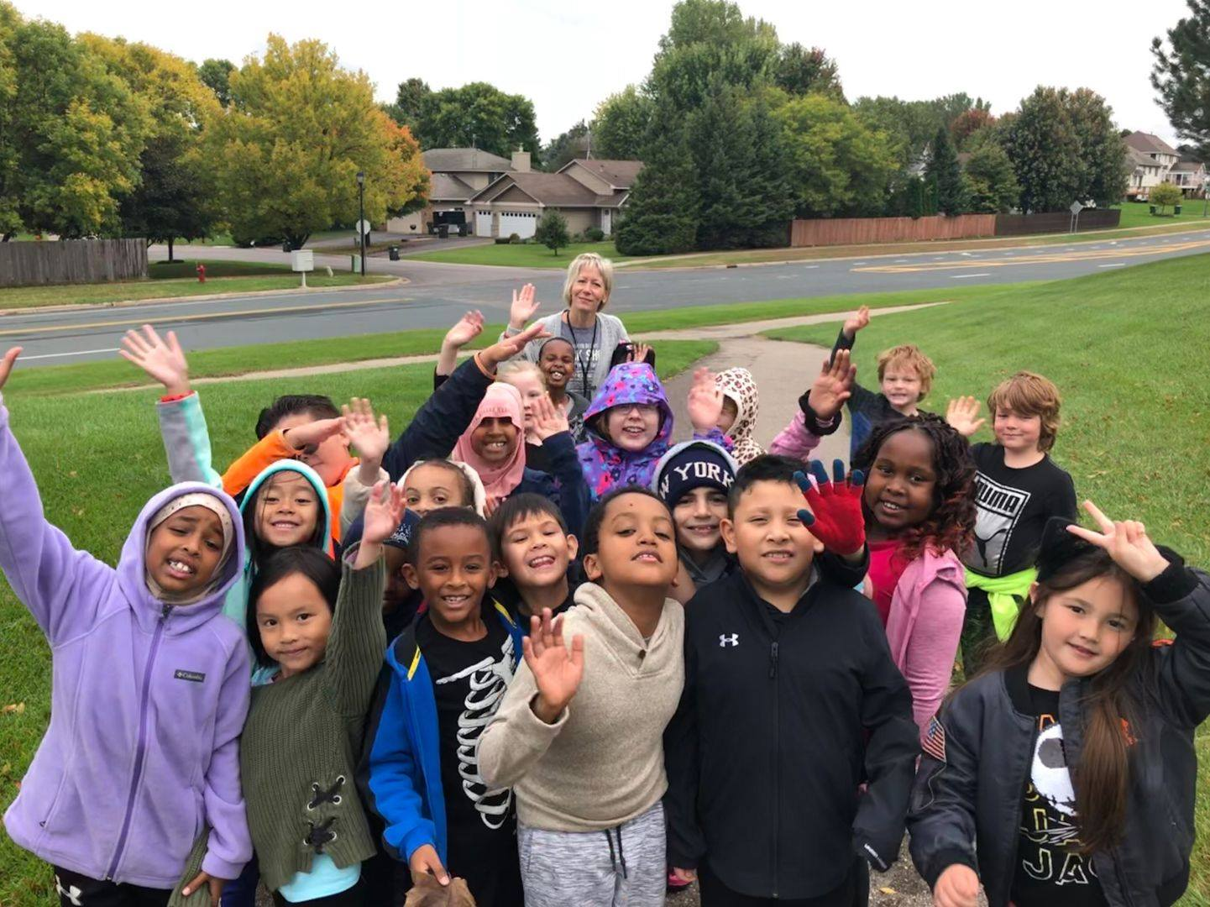
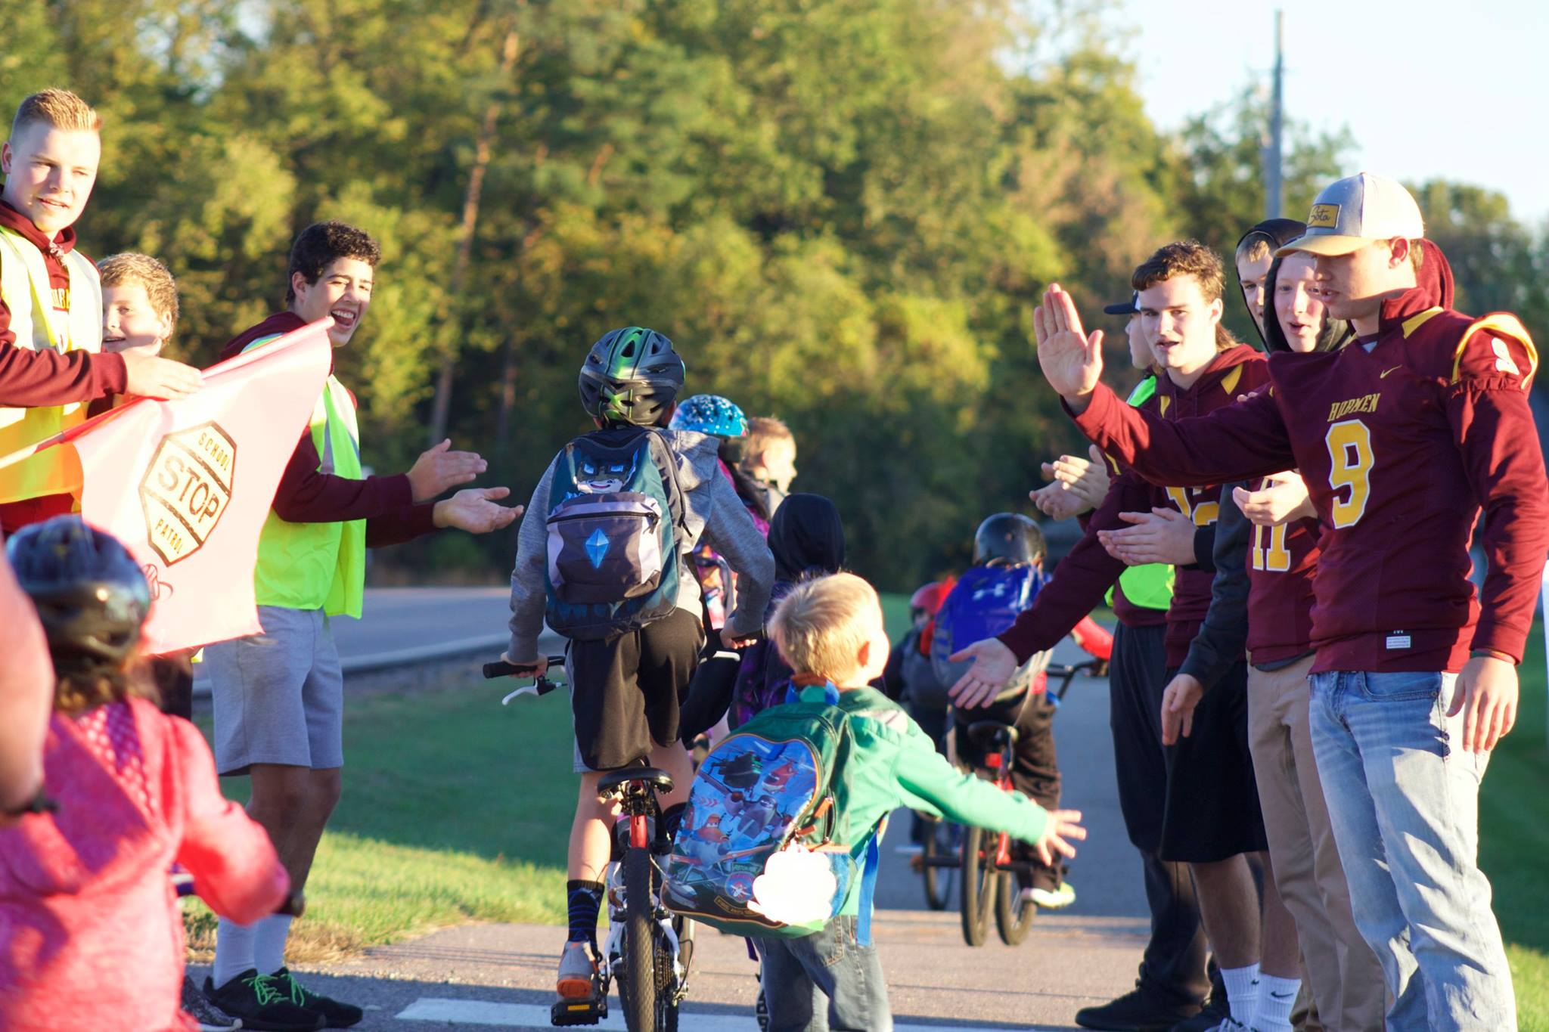
Ditch the drive and get outside!
WALK TO SCHOOL DAY
on October 12th
For more information, visit
www.mnsaferoutestoschool.org

Slide 2
ENTER OUR PHOTO CONTEST ON FACEBOOK
Give it a shot! #mnwalks
Walk to School Day
is October 12th
facebook.com/ MinnesotaSafeRoutestoSchool

Slide 3
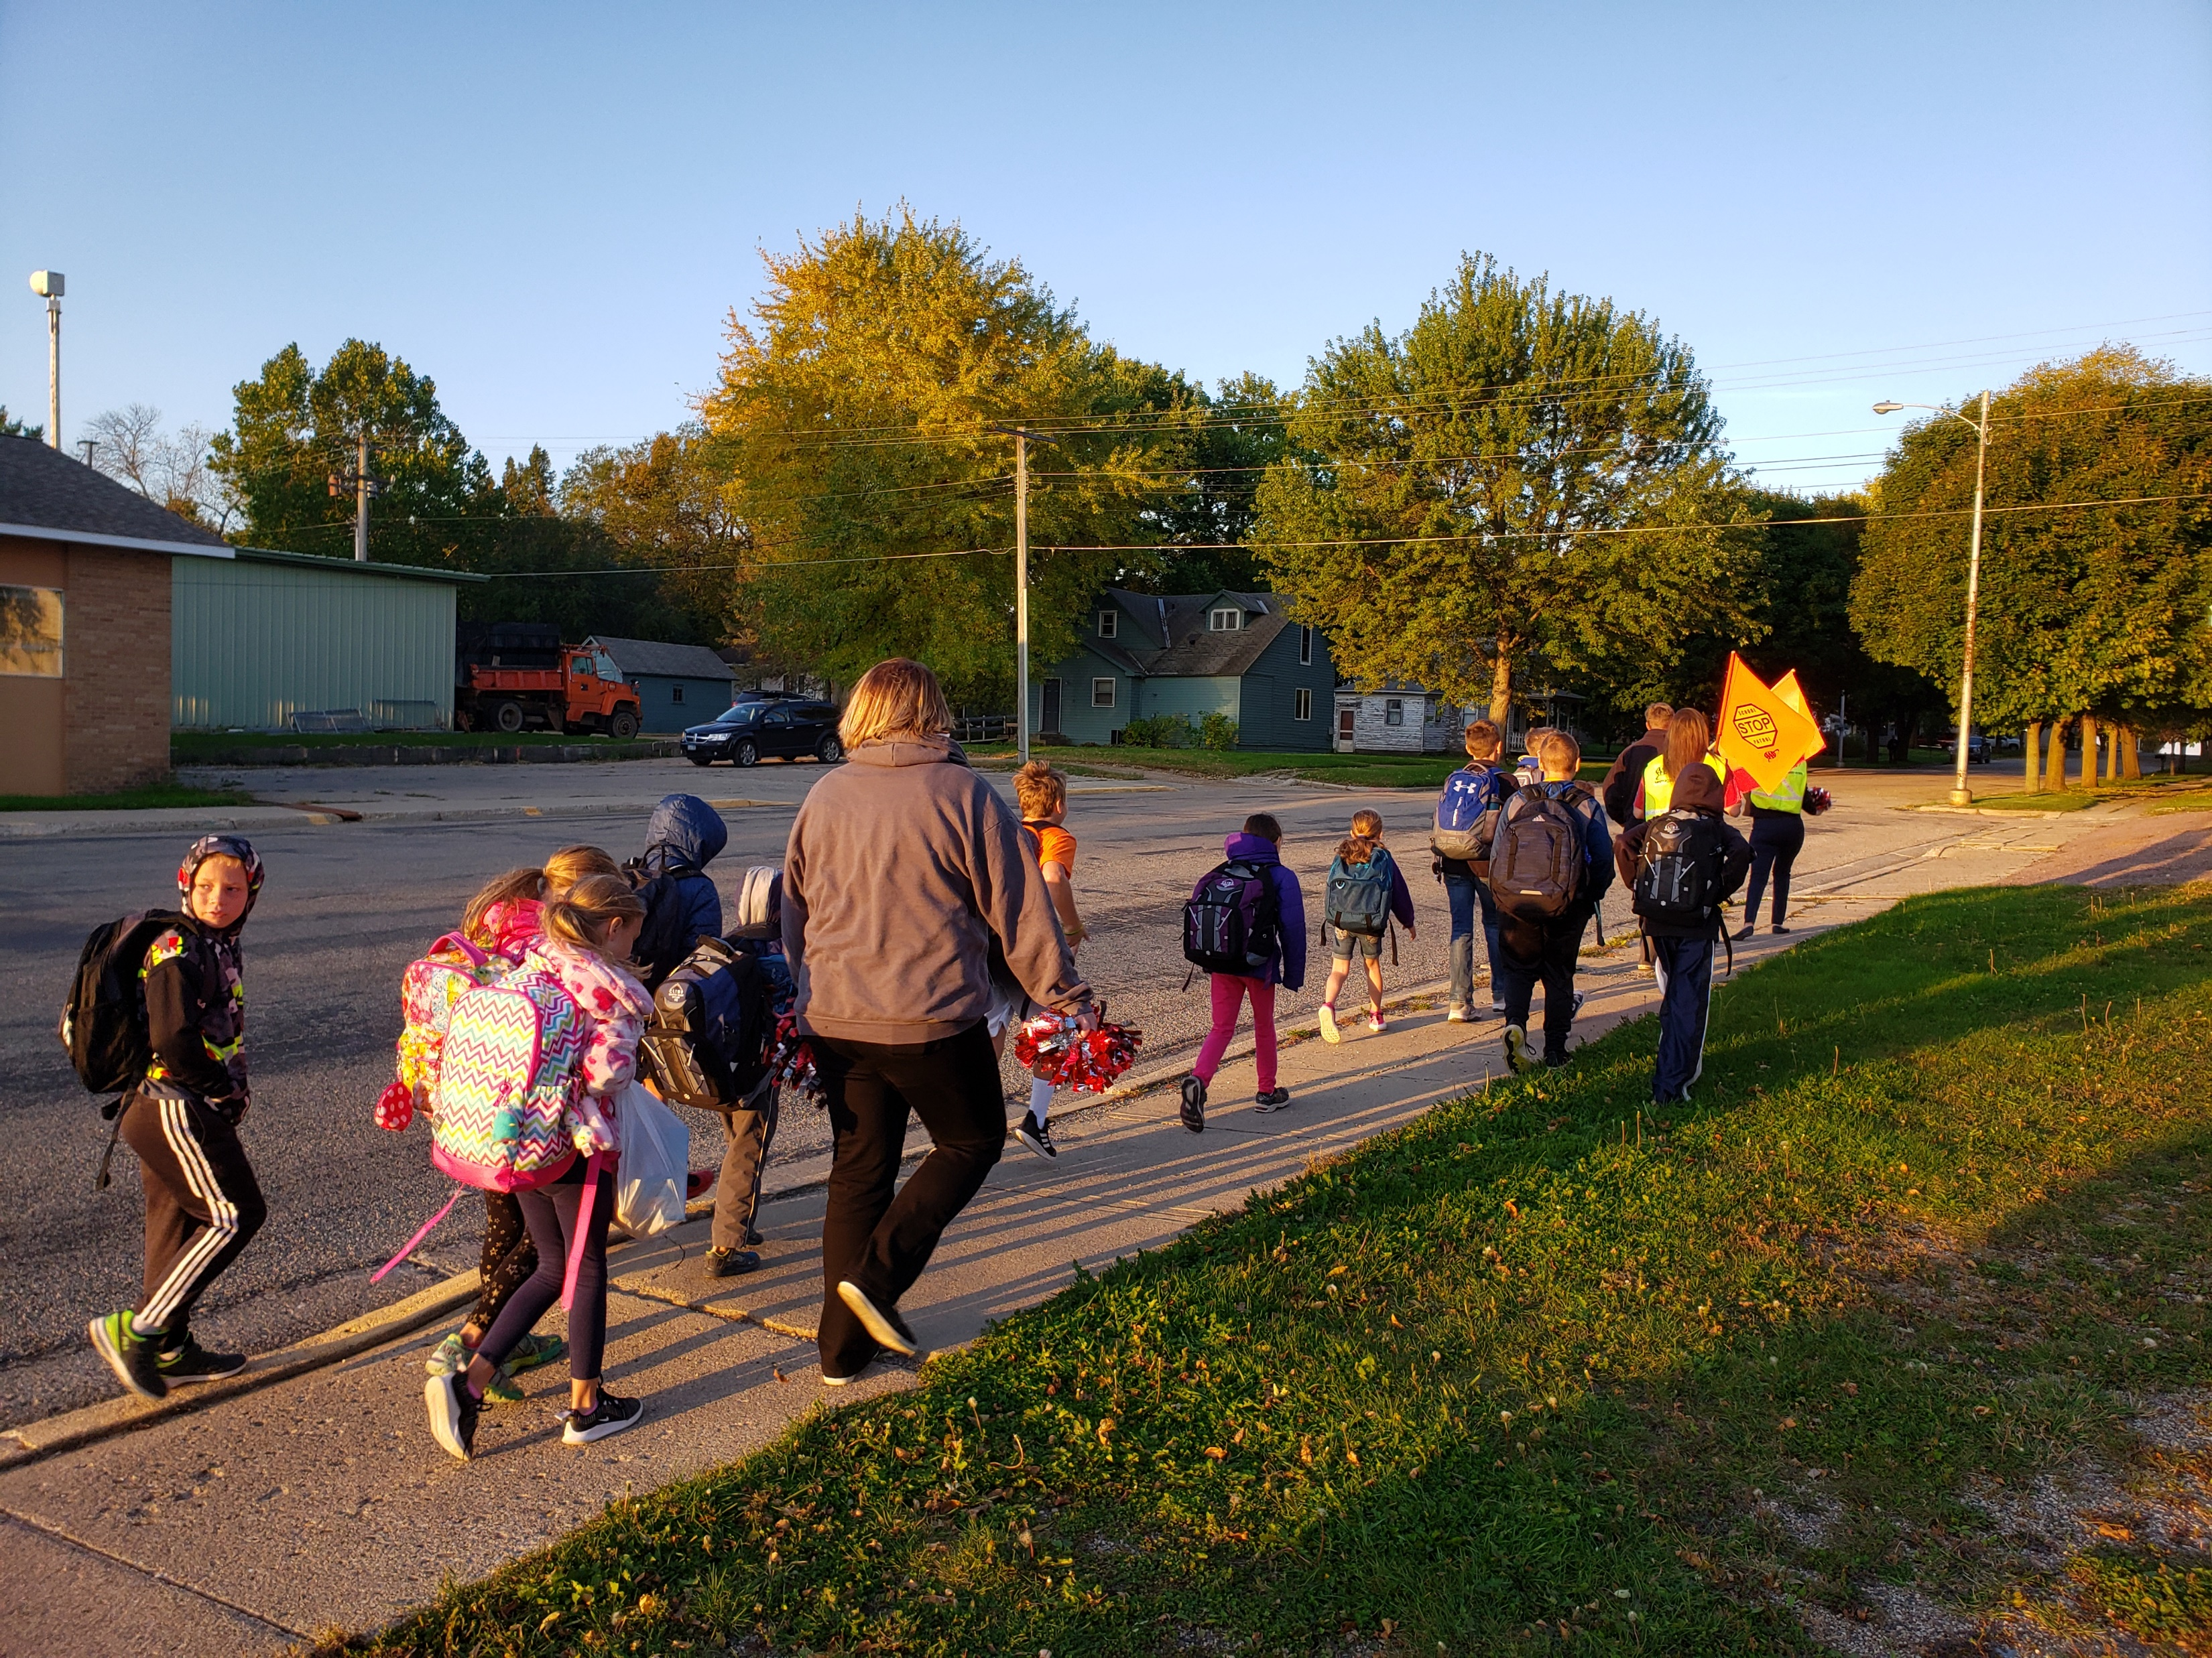
Kick of the new school year as a parent volunteer!
WALK TO SCHOOL DAY
on October 12th
Lead a walking school bus, greet students, serve refreshments, give out prizes, and more!
For more information contact:
[name, email, phone]

