Slide 1
School Siting in Minnesota:
Process & Considerations
Notes:
Speaker introduce self.
I’m going to give you an overview of how school siting works in Minnesota and what key considerations are in this process, with a focus on the importance of community-centered schools.

Slide 2
Agenda
Introduction: School Siting Trade Offs
Trends in School Siting
Benefits of Community-Centered Schools
Process
Moving Forward
Notes:
In the next 20 minutes, I’m going to provide a quick introduction to the choices and trade offs involved in school siting. I hope you come away with an understanding of trends and patterns involving school location, some of the benefits of community centered schools, and an understanding of how the process of getting a new school sited works in Minnesota. All of this will help us gain more clarity about how we can move forward to make sure that community values are included in school siting decisions here in our community.

Slide 3
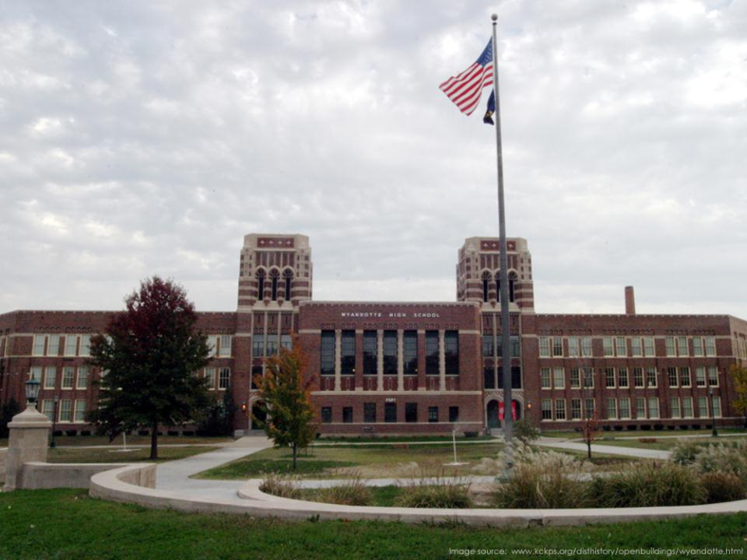
Introduction
School Siting Trade Offs
Notes:
Let’s start with an overview of the issue of school siting and the challenging trade offs involved.

Slide 4
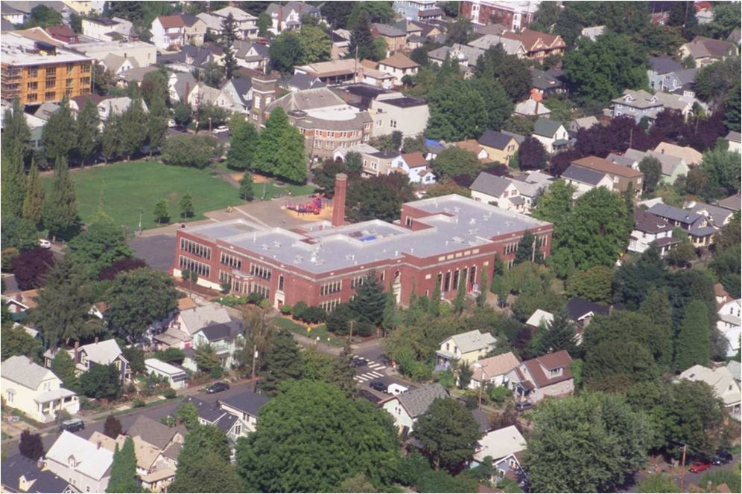
School Siting: The Challenge
How can we build walkable, diverse, affordable, conveniently located schools that support quality education, vibrant neighborhoods, walking and biking, & community needs?
Notes:
Let’s start with the big picture: Most people agree that we want to see schools that are walkable, affordable, racially and economically diverse, and conveniently located, that are supporting quality education, vibrant neighborhoods, walking and biking, & community needs.

Slide 5
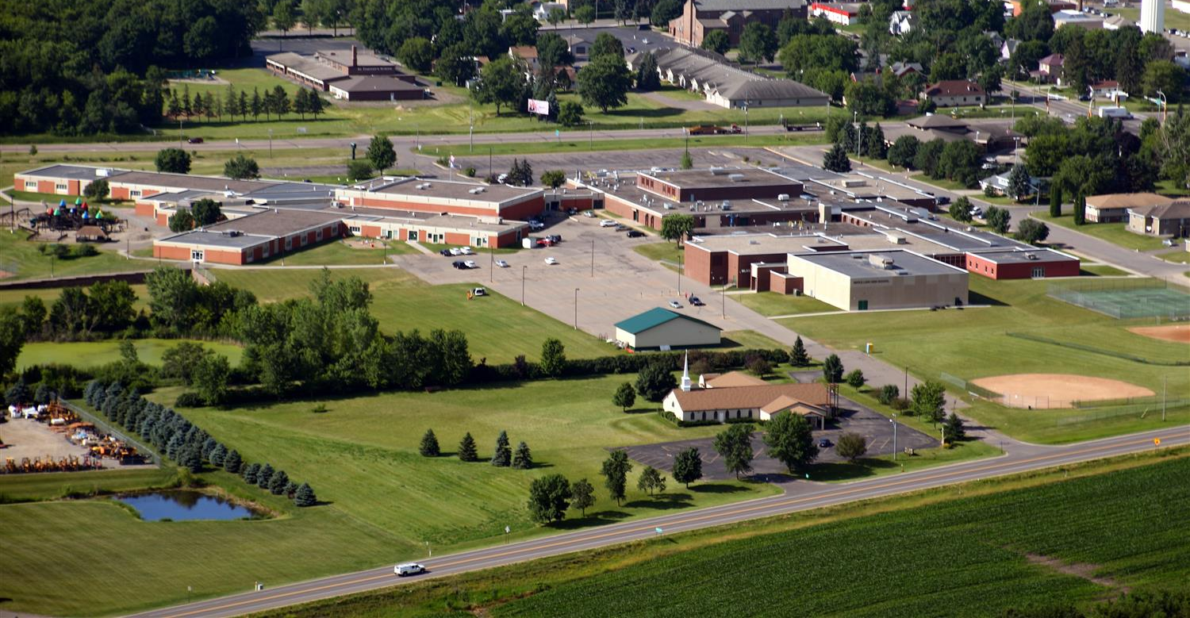
Notes:
New schools look a variety of ways in Minnesota and beyond. Some are big and sprawling, with acres of playing fields, and are located in the middle of farmland.

Slide 6
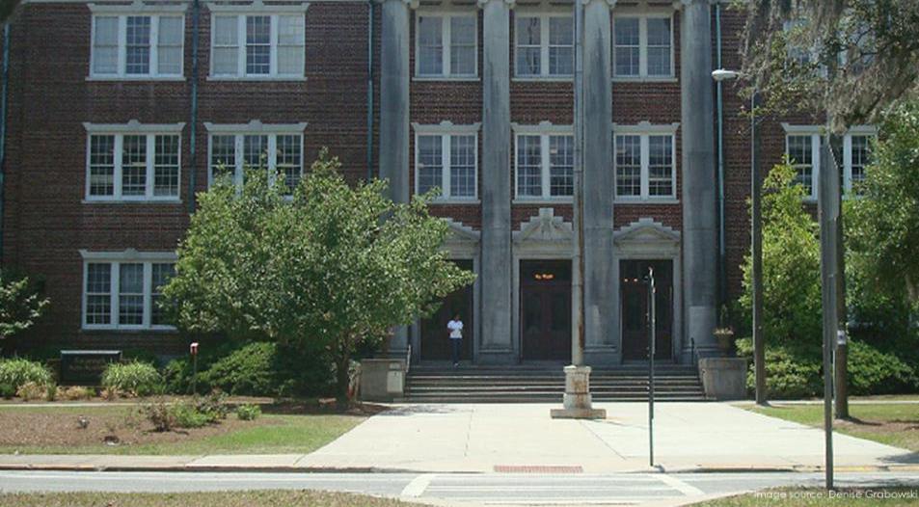
Notes:
Others are tucked into neighborhoods in cities.

Slide 7
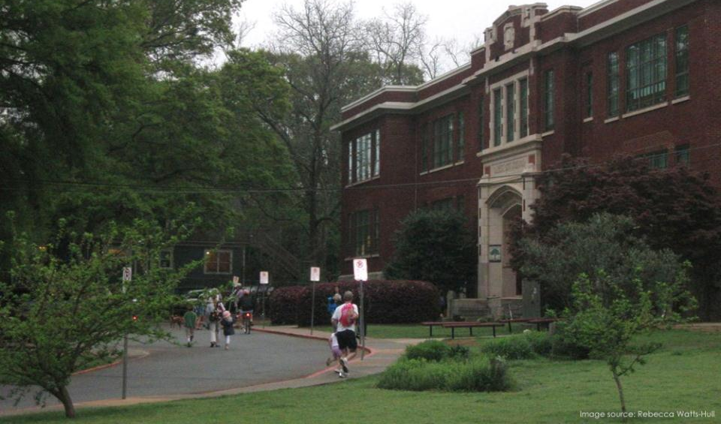
Notes:
Schools that are located near students’ homes are convenient – they make it easy for kids to walk and bike to school, for parents to run over for a PTA meeting or teacher conference, and for neighbors to use outdoor facilities on weekends or during the summer.

Slide 8
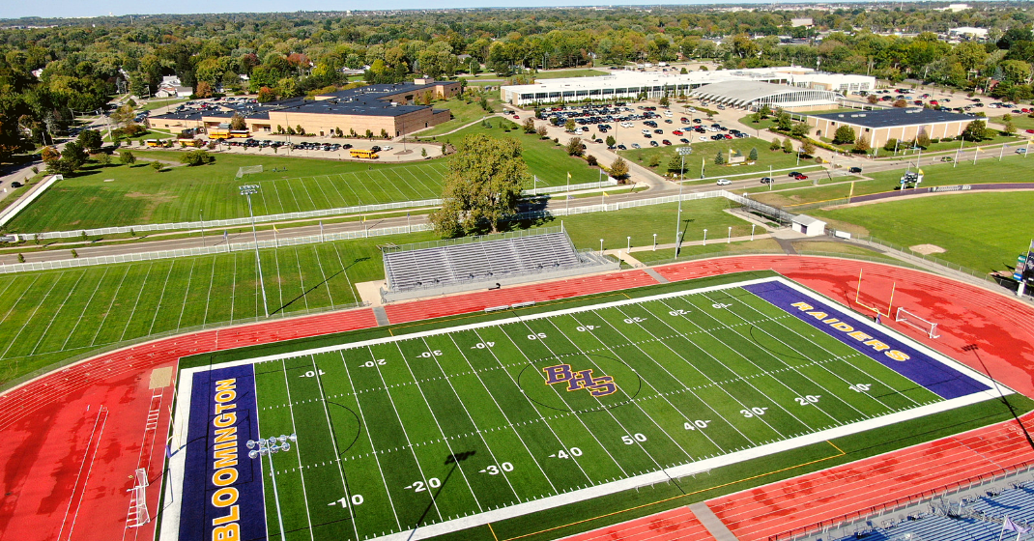
Notes:
There are fewer space constraints when schools are located out in the countryside, making it easy to include large playing fields, multibuilding facilities, and very substantial campuses.

Slide 9
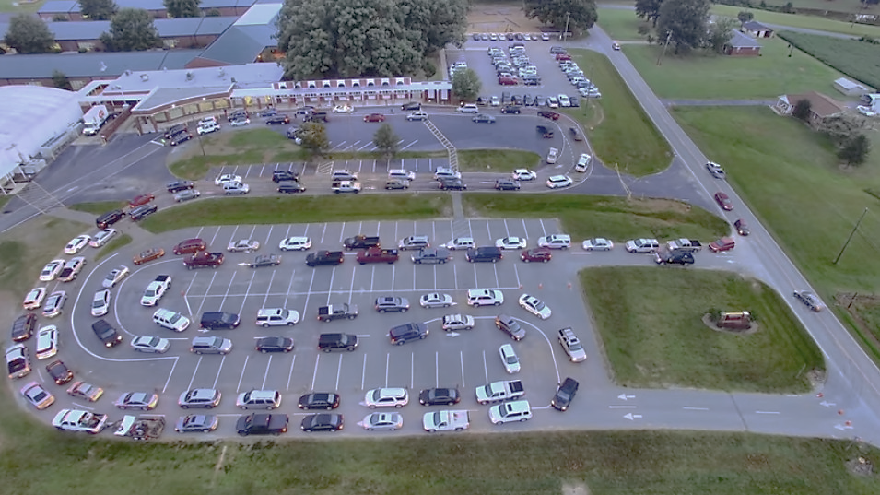
Notes:
Schools that are located far residences can be designed to accommodate many car drops off – but there are costs, in terms of time, exposure to toxic car idling fumes, and land use.

Slide 10
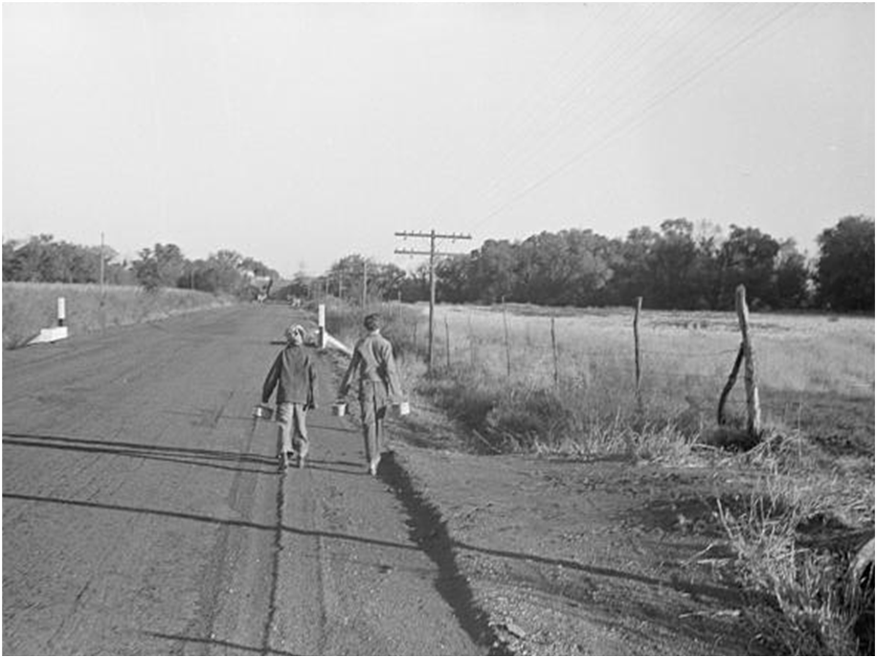
Troubling Trends
Schools located further from students’ homes than in past
In 1969, 45% of students lived a mile or less from school
By 2001, 24% of students did
Notes:
Overall, trends in the US show many students’ experiences changing from community centered schools to more distant schools.
In 1969, 45% of students lived a mile or less from school
By 2001, 24% of students did

Slide 11
Benefits of Community- Centered Schools
Notes:
In light of that, let’s talk about benefits of community centered schools.

Slide 12
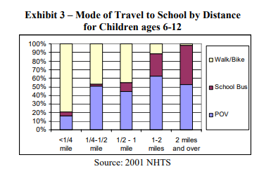
Why Does School Siting Matter?
Distance from school is directly related to how many students walk or bicycle
Notes:
First, it is important to see how distance of homes from schools affects student travel. This chart shows that when kids live within a mile of school, almost half of them walk or bike to school. That number rapidly falls off as distance increases, with more than half of kids being driven by parents at further distances and the remainder taking school buses once schools are more than 2 miles from students’ homes.

Slide 13
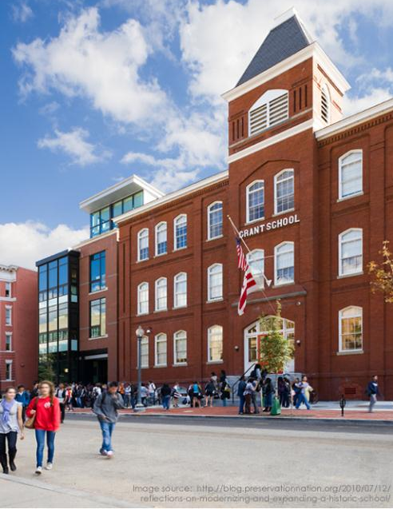
Why Does School Siting Matter?
Community-centered schools support
Physical activity, health & academics
Walking & biking: Walking & biking to school rates fell from 48% to 13% as distance to school grew from 1969 to 2001.
Physical activity: Kids who walk or bicycle to school get more physical activity; have lower risk of obesity & diabetes; have better overall health; benefit academically
Notes:
Community centered schools support students’ physical activity and health, which are closely linked to many measures of academic achievement.
Walking & biking: Walking & biking to school rates fell from 48% to 13% as distance to school grew over a thirty year period – those physical activity levels go back up when schools are located near students’ homes.
Physical activity: Kids who walk or bicycle to school get more physical activity; have lower risk of obesity & diabetes; have better overall health; and show academic benefits from improved attention spans, better performance on tests, and higher graduation rates.
https://www.cdc.gov/healthyschools/health_and_academics/index.htm

Slide 14

Why Does School Siting Matter?
Community-centered schools support
Healthy air & lungs
Schools located far from residences increase driving & contribute to poor air quality at a community level.
When kids spend more time in buses or cars, they are exposed to worse air quality than when they walk or bike, due to high concentrations of pollutants inside vehicles.
Air pollution causes asthma, respiratory infections, lung & heart disease. Poor air quality can lead to academic harm.
Notes:
Community centered schools also matter for healthy air and lung health.
Schools located far from residences increase driving & contribute to poor air quality at a community level.
When kids spend more time in buses or cars, they are exposed to worse air quality than when they walk or bike, due to high concentrations of pollutants inside vehicles.
Air pollution causes asthma, respiratory infections, lung & heart disease. Poor air quality can lead to worse academic performance.

Slide 15
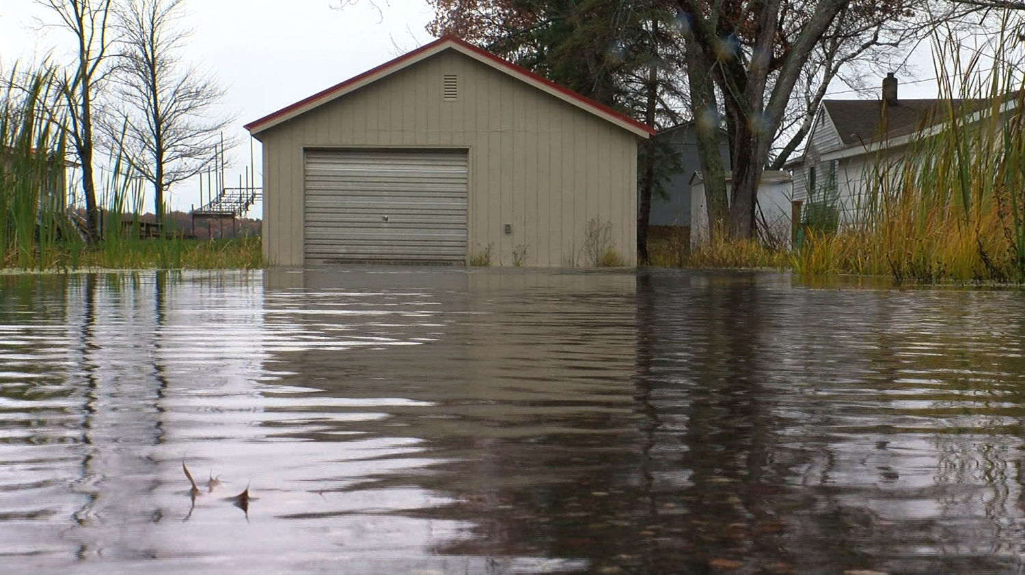
Why Does School Siting Matter?
Community-centered schools support
Climate
Climate disasters are mounting
Transportation is biggest contributor to emissions in US & MN.
Reducing emissions requires more walking & bicycling, less driving, electric vehicles, & compact development.
Notes:
Community centered schools also matter for the rising threat of climate change
As we know, Climate disasters are mounting, with increasing flooding and storms affecting Minnesota.
Transportation is the biggest contributor to emissions in the US & MN.
Reducing emissions requires more walking & bicycling, less driving, electric vehicles, & compact development.

Slide 16
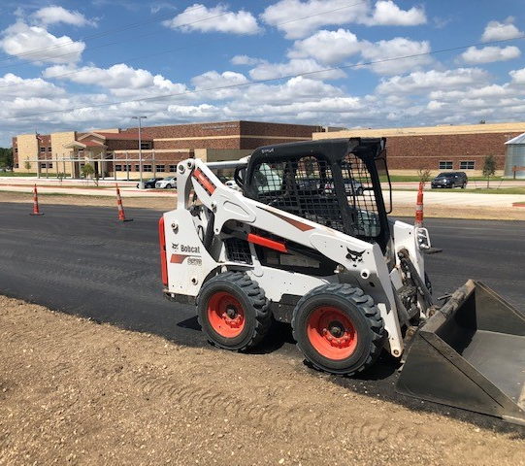
Why Does School Siting Matter?
Community-centered schools support
Cost effectiveness
For schools: $17 billion/yr for school buses; gas volatility
Families: Cost of gas & commute time
Cities/towns: Cost of maintaining roads & services
Notes:
Community centered schools are also more cost effective:
In the US, school districts historically pay more than $17 billion/yr for school buses, but are struggling to hire drivers and are seeing costs soar due to gas volatility, wage increases, and so on.
There are costs for families too – the cost of gas & commute time to drive kids a long way to school
There are also a range of costs for cities/towns -- Cost of maintaining roads & services, the need to build or find alternative sites for community centers and needs, and so on

Slide 17
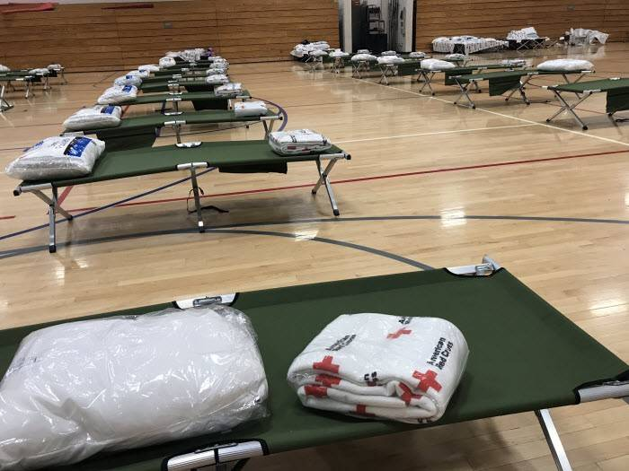
Why Does School Siting Matter?
Community-centered schools support
Community access & emergency center
Recreational uses by community members during weekends & summers
Emergency gathering place & shelter for disasters (when driving may become impossible)
Convenient location for voting or community meetings
Notes:
Community centered schools also support community access & emergency center
Community centered schools allow recreational uses by community members during weekends & summers
Schools can be safe and convenient emergency gathering places & shelter during disasters, when driving may become impossible and ease of access is critical
Community centered schools also foster social bonds and serve as a convenient location for voting or community meetings

Slide 18
Trends in School Siting in Minnesota
Notes:
Let’s turn to talking about what we are seeing around school construction in Minnesota

Slide 19
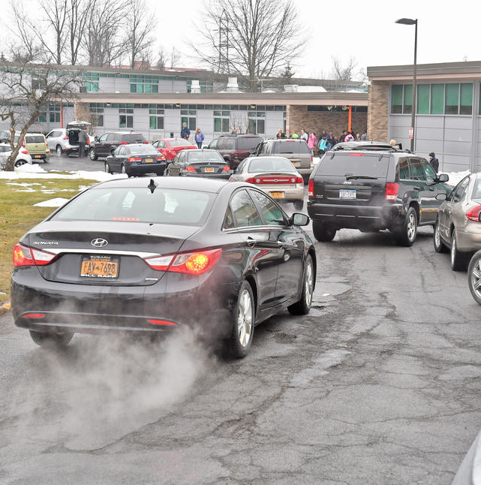
How Does this Play Out in Minnesota?
Parents & principals describe distance as a barrier to walking
Large minimum acreage guidelines in school construction approvals
Dangerous walking/biking conditions at new schools
Notes:
How does this look in MN?
School construction is often generating schools that are not walkable or friendly to SRTS
In one study, 75% of MN parents said distance affected decision re students walking/biking to school
70% of MN principals said distance was a major or moderate barrier to students walking & biking
School construction approval favors large minimum acreage requirements & requires justification for smaller/renovated sites
Many new schools asking Safe Routes to School professionals & Minnesota Department of Transportation for help with dangerous arrival/dismissal conditions

Slide 20
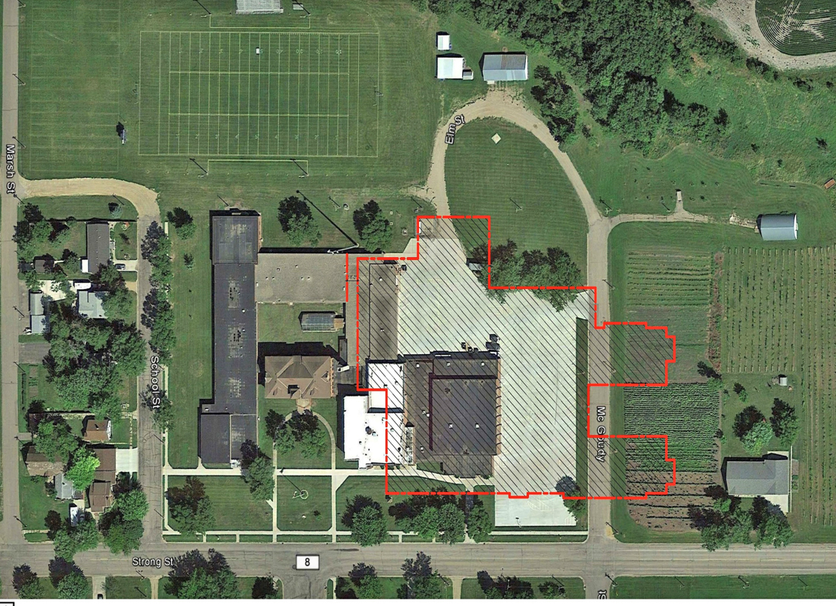
What Drives
Unwalkable School Siting in MN?
Ease of buying affordable land and building on greenfields
Desire to avoid future obsolescence due to insufficient space – large sites allow addition of new buildings and site features
Customary practice
Short term cost/benefit analysis
Districts don’t bear many of the costs
Notes:
What is leading to unwalkable and sprawling school siting trends in Minnesota?
It is easier to build in the countryside – land is cheaper and there are fewer constraints or challenges in building on greenfields
Desire to avoid outgrowing space in the future – large sites allow addition of new buildings and site features
Customary practice -- It’s how things have been done based upon past decades’ development trends toward suburbs and sprawl. It’s hard to change that overnight.
Other factors include short term cost benefit considerations, and the fact that districts make the decisions but don’t bear many of the costs, like family commute costs, street repair, and need for duplicate community facilities.

Slide 21
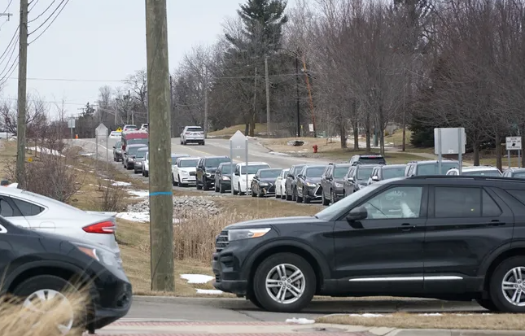
State Construction Guidelines Play a Role in Unwalkable School Siting Trends
Effects of MDE’s School Construction Guidelines and approval process:
  Favor large sites & new construction
  Little consideration of walkability or proximity
  Why? Fear of outgrowing space, but not fears related to student health, air pollution, or climate
Notes:
In addition, the MN Dept of Education’s School Construction Guidelines and approval process drives this trend too.
Although the guidelines are recommendations and are not mandatory, they favor large sites & new construction – in fact, Minnesota has the largest minimum acreage recommendations in the country, and these influence districts’ decisions.
There is very little consideration in the school construction guide for walkability or proximity
Why? As noted above, MDE priorities are being driven by fears of outgrowing space, which is a reasonable concern -- but the priorities are not really considering or addressing issues related to student health, air pollution and emissions, loss of agricultural land, or concerns about climate change

Slide 22
MN Stats at a Glance
Students
851,000 students in public schools
Student demographics: White (72%), Black (11%), Latinx (8%), Asian/Pacific Islander (7%), American Indian (2%), eligible for free/reduced lunch (39%)
Segregation an increasing issue
25% of Black students in the Minneapolis area are in hypersegregated schools
School buildings
Schools by the numbers:
  328 school districts
  2500 schools
  170 charter schools
Average age of school building in US: 42 years
Minnesota school construction:
  15 new/fully remodeled schools/year
  25 major renovations/year
  2014 estimate: MN schools have $3.7 billion in infrastructure needs
Notes:
[Okay to omit if too much content]
What do overall conditions look like in Minnesota?
The big picture is: There are more than 800,000 K-12 students, majority White student body with 28 percent students of color, & increasing issues around school segregation
There are 328 school districts, aging schools, only a few renovations or new schools per year, and billions of dollars in backlogged infrastructure need.

Slide 23
Process
Notes:
How does school siting work in Minnesota?

Slide 24

MN school construction process
District identifies a need/interest in new/renovated facility & assembles some type of site selection committee
Site selected, pre-design estimates take place
Plan submitted to MDE commissioner for state review & comment
If review positive, proposal goes to voters for approval of financing
If financing approved, then site design takes place
New construction/renovation occurs
The gist:
Site selection & funding occurs at local level, but required state approvals strongly influence decisions towards large, walk/bike unfriendly sites.
Notes:
How does school siting work in MN?
In a nutshell, the MN school construction process generally works like this:
The school district identifies a need/interest in new/renovated facility & assembles some type of site selection committee
A site or a few alternative sites are selected & pre-design cost estimates take place, with the help of a school planning firm
The plan is submitted to Minnesota Dept of Education commissioner for state review & comment
If the review is positive, proposal goes to voters for approval of financing
If financing is approved, then site design takes place
Then, finally, new construction/renovation occurs
The two bolded points are the opportunities for community input.

Slide 25
Moving Forward
Notes:
So what choices are under consideration here, and how should decisionmaking proceed?

Slide 26

Notes:
There is no “easy” button for school siting. It is a complex process that requires a community to make choices about how their values are reflected in their schools.

Slide 27
Traffic & parking
Future of
existing school
Equity
Toxic contamination
Safe walking &
biking for students
Student Population
Acreage Requirements
Convenient Access
Utilities
Construction Costs
Operating
costs
Test scores
Coordinated
planning
Community
Values
Learning
environment
Regional
transportation
Diversity
Neighborhood
impacts
Transportation
costs
Air pollution
Playing fields
Adjacent
land uses
Public
involvement
Student
health
High performance,
healthy school
Renovate or
reuse versus
new construction
Politics
Attendance
zones
Climate impacts
Community uses
Notes:
At first glance, there seem to be some pretty basic criteria that influence where a school will go.
[CLICK]
But in reality, the complexities surrounding school siting are enormous. There’s seldom – if ever – such a thing as a perfect location. Today’s conversation is only the tip of the iceberg.
With so many key considerations and trade offs, at the end of the day… [CLICK] it’s all about community values.

Slide 28
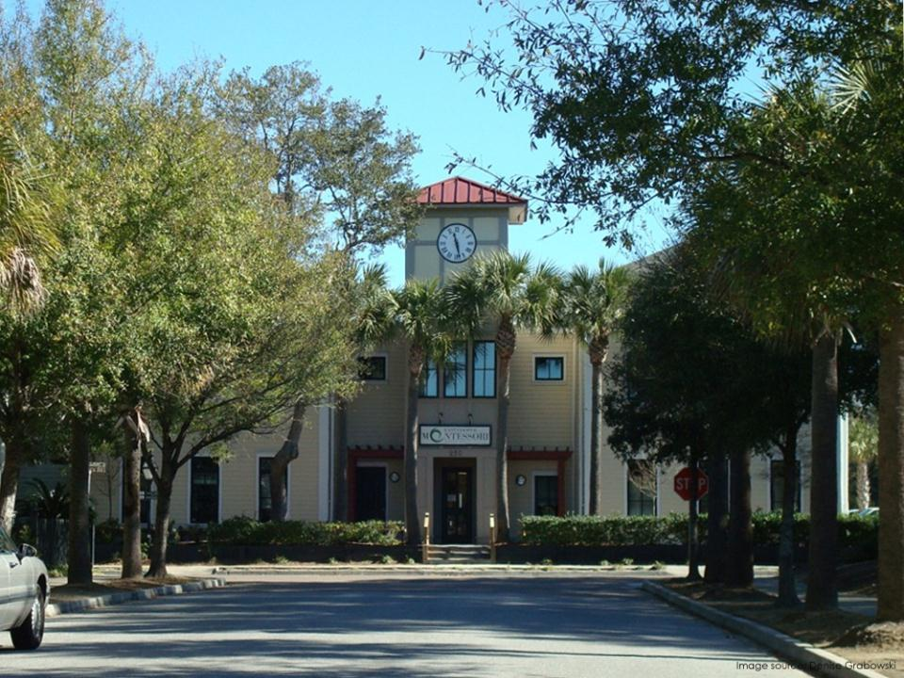
Next Steps & Opportunities: For Current Decision
For current decision
Identify community values, goals, priorities for specific school siting decisions
Input & opportunities for school siting committee
Support financing
Community input into site design
Notes:
What do next steps look like for making such complicated decisions?
First, we are going to work today and in the future to develop a sense of our community values and priorities for school siting in this case. We’ll be doing an exercise shortly to help start to figure out our priorities.
Additionally, a community school siting committee is a great way to ensure that different voices and needs are heard and many factors are weighed in. [Describe current status – formed, agreed to, need to request]
Once a good site is selected and state approval is secured, there are key steps for the public related to helping provide information and support for the school construction financing referendum that will take place [Be careful in discussing support based on whether there are any restrictions on speaker’s ability to lobby or otherwise advocate.]
There are important opportunities for community input into the design of the site, participating in communities or weighing in about the need for bike paths and bike parking, connected sidewalks, keeping parking lots and vehicle drop off areas away from main entrance and keeping travel modes separate, and so on.

Slide 29


School Siting Committee
Stakeholders
Parents
School
Board
Teachers & Staff
Nonprofit Groups
Students
Local
Govt.
Planners
Engineering
Parks & Rec.
Elected Officials
Facility Staff
Admin
Notes:
A couple more words about school siting committees. These are a best practice recommended in the EPA’s School Siting Guidelines to get input from the many diverse stakeholders in the process. Responsibilities of a school siting committee include making participating in the review of potential sites and making site selection recommendations.
The formation of a school siting committee should be a very transparent process. Specific groups represented on the committee may vary for different communities, but here you can see a sample of what the representation may look like.

Slide 30
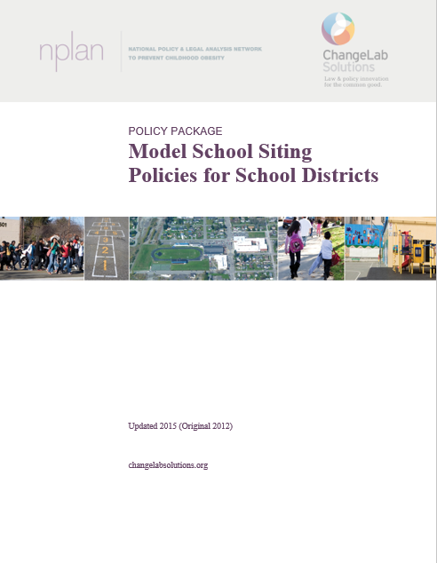
Next Steps & Opportunities: For Future Decisions
Bigger picture steps
Develop community priorities for new schools, renovations, and closures in general
Adopt school siting district policies that embody community values
Notes:
Bigger picture, there are also key things to do to ensure that we have a good foundation in place for what we know will be ongoing school siting, construction, and renovation needs.
These include ensuring that we have a good sense for our community priorities and values for new schools sites as a general matter. Community discussions, PTA conversations, surveys, working groups, and more can ensure that the community is able to articulate its priorities. These need to be regularly revisited.
Another important approach includes adopting school district policies that embody these values and set out a process for school siting decisions that includes priorities and engagement. Without this kind of strong policy, we may find ourselves reinventing the wheel every time these decisions arise.

Slide 31
Insert Contact Info
Notes:
Thank you so much – let’s get on to the next steps in our meeting!
[Pass off to next speaker/facilitator]

