Slide 1
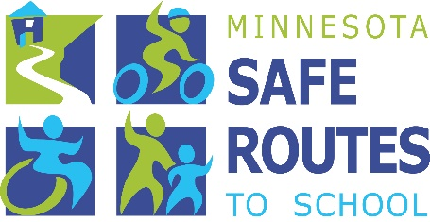
Minnesota Safe Routes to School Improving Health, Safety, and Transportation
Notes:
To the presenter:
This presentation provides a brief overview of Safe Routes to School Programs and why they are important.
Each slide contains speaker notes with key points and citations are provided where relevant. Where appropriate, image location information has been placed on the slide for the audience to see.
Please go to www.saferoutesinfo.org for further information on any of the topics mentioned in this presentation.
Learning objectives:
Upon completion of this presentation, listeners will:
Be able to explain why fewer children are walking and bicycling to school and what caused this shift from several decades ago.
Be able to describe the consequences of fewer children walking and bicycling to school.
Be able to describe elements of Safe Routes to School programs.
Image:
Latham Elementary School, Winston-Salem, NC provided by Mike Cynecki.

Slide 2
Why Safe Routes to School?
Fewer kids today walk and bike to school
This has resulted in unintended consequences
SRTS programs can be part of the solution
Notes:
Message:
I’m here today to talk about the benefits of walking and bicycling for children, what’s keeping kids from walking and bicycling to school, and how SRTS programs can help. Let’s begin by framing the issue:
A major decrease in the number of children who walk and bicycle to school has occurred over the last generation or so.
This decline has resulted in unintended and far-reaching consequences for both our children’s lives and our own.
Safe Routes to School programs empower communities to make walking and bicycling to school a safer, more popular way to get to school.
Let’s explore these areas in more detail.
Image:
Christa McAuliffe Elementary School, Lenexa, KS, provided by Mike Cynecki.

Slide 3
Fewer kids are biking and walking More parents are driving
1969 | 2009
48% walked or biked | 13% walked or biked
12% driven | 44% driven
Notes:
Message:
Today fewer children are walking and biking and more parents are driving.
Only a generation ago, children routinely traveled around their neighborhoods either on foot or on bike. Walking and bicycling were common ways to get to school.
Today, few children (ages 5 to 14 yr. old) walk or bike.*
And as traffic increases, parents become even more convinced that it is unsafe for their children to walk. They begin driving their children to school, thereby adding even more cars to the morning chaos.
Note to presenter:
Optional: Ask all of the adults in the room who walked or bicycled regularly to school to raise their hands. Now ask how many have children in their lives (sons, daughters, grandchildren, neighbors) who walk or bike to school. There’s likely a large difference.
Citation:
*The National Center for Safe Routes to School and the Safe Routes to School National Partnership (2010). U.S. Travel Data Show Decline In Walking And Bicycling To School Has Stabilized: Safe Routes to School Programs Encourage Active, Safe Trips to School. Chapel Hill, NC & Boulder, CO. [Press release] Available: https://www.saferoutespartnership.org/media/pressreleases/US-Travel-Data-Show-Decline-in-Walking-and-Bicycling-to-School-Has-Stabilized.
Image:
Chamberlin Elementary School, Burlington, VT provided by Mike Cynecki.

Slide 4
School travel by private vehicle accounts for 10-14% of morning rush hour traffic.
(McDonald, Brown, Marchetti, Pedroso, 2011)
Notes:
Message:
For most communities, this picture is the norm.
Parents driving their children to school make up 10-14 percent of the morning commute.*
Citations:
*McDonald N., Brown A., Marchetti L., Pedroso M. (2011). U.S. School Travel 2009: An Assessment of Trends. American Journal of Preventive Medicine, 41(2), 146-151.
Image:
North Carolina school site, provided by Joel Cranford.

Slide 5
What caused the shift?
Notes:
Message:
Let’s dig a little deeper to discover the underlying reasons for this shift in transportation habits.
How have schools changed?
How have parents and students changed?
What are the community issues involved?
Image:
Second Street School, Frankfort, Kentucky, provided by Mike Cynecki.

Slide 6
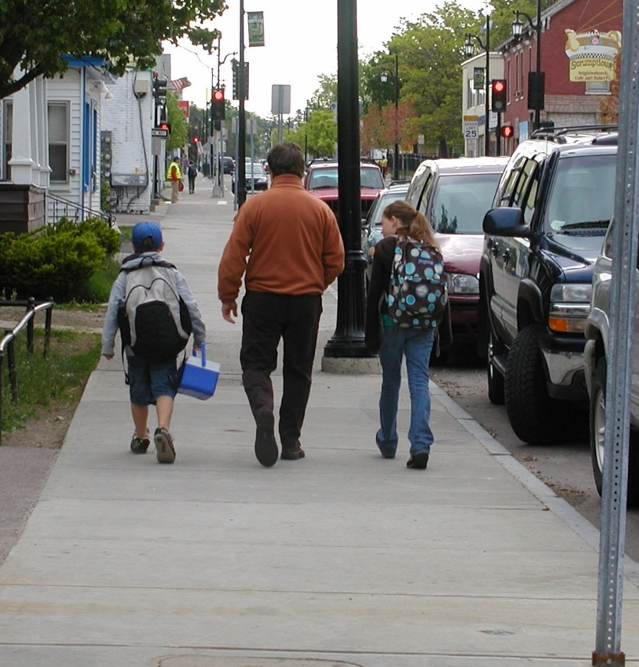
School siting: A generation ago
Small (average of 127 students)
Located in community centers
48% of kids walked or biked to school
(EPA, 2003)
Notes:
Message:
School locations have changed a lot in recent years.
A generation or more ago, schools were small and located in the centers of communities.
The close proximity of schools to residential neighborhoods encouraged walking and biking.*
Citations:
Roughly 48 percent of students (ages 5-14) walked or biked to school in 1969.
*Travel and Environmental Implications of School Siting (2003). Washington DC: Environmental Protection Agency, Report No. 231-R-03-004 Available at http://www.epa.gov/smartgrowth/pdf/school_travel.pdf.
Image:
Barnes Elementary School, Burlington, VT provided by Mike Cynecki. (Note: this image was taken in 2008 near a centrally located school site.)

Slide 7
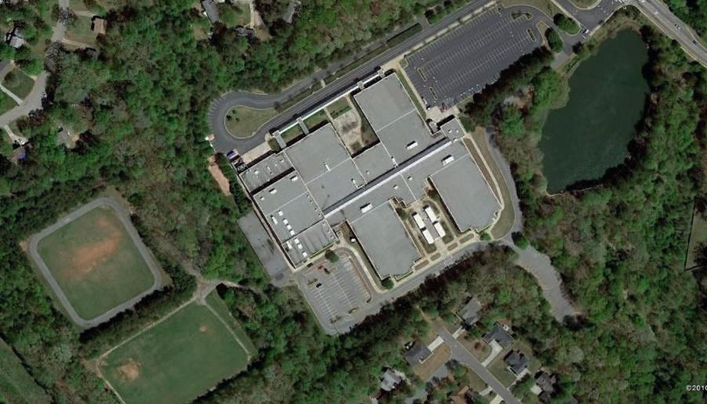
School siting: Today
Current average enrollment: 517 students
Mega-schools: up to 2,800 students
Schools located on 10 to 30+ acres fringe land
Lowest-cost construction
(National Center for Education Statistics, 2012)
Notes:
Message:
Today, schools are built to accommodate a far larger number of students. In the 2010-2011 school year, the average school attendance for elementary and secondary schools was 517 students.*
Some “mega-schools” may house up to 2800 students, such as the school shown in this photo.
Schools are increasingly being built on fringe land on the periphery of towns and cities.
By increasing the distance between home and school, these more distant schools often remove the option of physically active trips to school and encourage higher levels of auto use and pollution.
Citations
*National Center for Education Statistics. Average enrollment and percentage distribution of public elementary and secondary schools, by type and size: Selected years, 1982–83 through 2010-11. Available at http://nces.ed.gov/programs/digest/d12/tables/dt12_107.asp.
Image:
Creekland Middle School, Lawrenceville, GA provided by Google, 2010.

Slide 8
It’s not just distance
Students living within 1 mile or less who walk or bike to school:
1969: 89%
2009: 35%
(USDOT, 2009)
Notes:
Message:
Even when children live within one mile or less of school, fewer are walking and bicycling than in the past.*
Citation:
*How children get to school: School travel patterns from 1969 to 2009. The National Center for Safe Routes to School. October 2011. Available at: www.saferoutesinfo.org/program-tools/NHTS-school-travel-1969-2009.
Image:
Destin Elementary School, Destin, FL provided by Dan Burden.

Slide 9
Most common barriers to walking and bicycling to school
Long distances 62%
Traffic danger 30%
Adverse weather 19%
Fear of crime danger 12%
Note: Sum of percentages is more than 100% because respondents could identify more than one barrier.
(CDC, 2005)
Notes:
Message:
The Centers for Disease Control and Prevention studied how many children walk and bike to school, and what barriers parents report that keeps them from allowing their children walk or bicycle.
While this report is from 2005, a report from the National Center for Safe Routes to School in 2010 found that these barriers remain the same.
Parents say that distance (which we’ve already discussed), traffic dangers, and adverse weather are the main reasons why their children don’t bike or walk to school.* Let’s talk briefly about each of these barriers.
Citation:
*U.S. Centers for Disease Control and Prevention. (2005). Barriers to Children Walking to or from School United States. Morbidity and Mortality Weekly Report. Available at www.cdc.gov/mmwr/preview/mmwrhtml/mm5438a2.htm.
Note to presenter: Survey respondents could identify more than one barrier so the sum of the percentages is more than 100%.

Slide 10
Traffic danger
Notes:
Message:
The second most common barrier to walking and bicycling to school that was reported by parents was traffic – parents feeling it is not safe for their children to walk or bike. Ironically, safety concerns often lead parents to drive their children to school, making it even less safe for others to walk and bike.
But we also need to acknowledge that many of pedestrian and bicyclist injuries and fatalities could likely be avoided if streets were made safer for walking and biking.
Image:
Browning Elementary, Milwaukee, WI, provided by Mark Fenton.

Slide 11
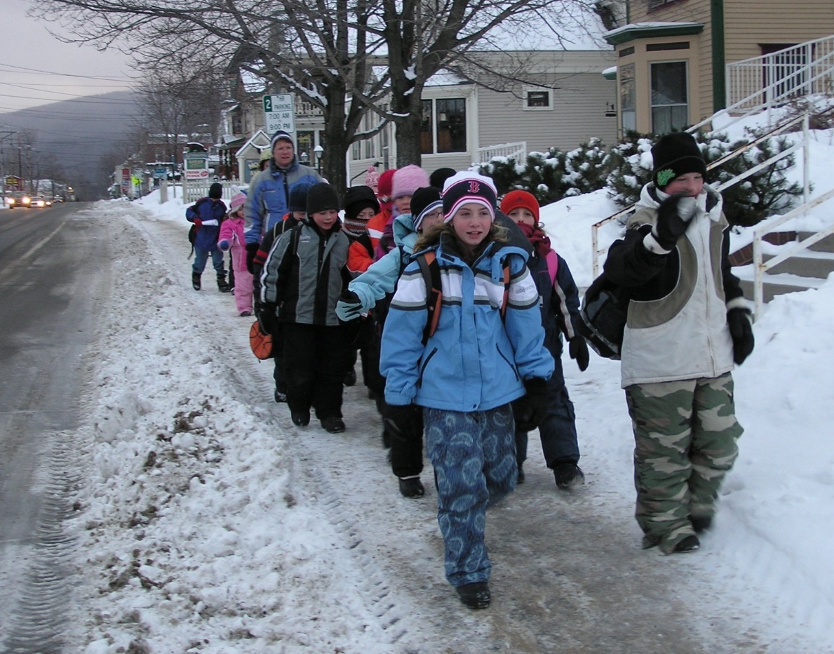
Adverse weather
Notes:
Message:
Adverse weather was the third most-cited reason parents gave for their children not walking or bicycling to school. However, the weather hasn’t changed much since a generation ago when so many children walked or biked.
Safe Routes to School efforts have been very successful in climates with all kinds of weather, from cities across Canada to Chicago, IL and Minneapolis, MN and Arlington, MA.
Images:
Walking school bus to Fenn Elementary School, Gorham, NH.

Slide 12
Fear of crime danger
Range of concerns is broad, often not unique to walking and bicycling to school
Both reality and perceptions need to be addressed
SRTS can be a part of a larger, community-wide response
Notes:
Message:
Parents often state being fear of crime as an obstacle to walking and bicycling to school.
Children and caregivers may face fears around bullying, personal violent crime, exposure to gang activities or abduction – not just on the trip to school, but also at school, on the playground, or during afterschool programs.
In some communities, these concerns pose a real challenge to keeping students safe. In other communities, the perception of what could happen is the greatest concern.
SRTS programs alone can’t fix personal security issues, but they can be an important component of a broader, community-wide, response.

Slide 13
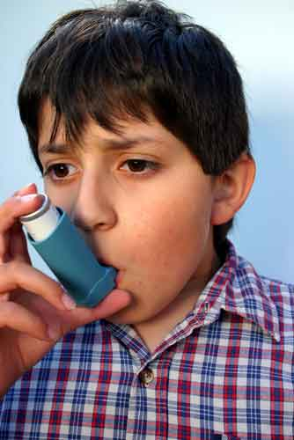
What are the unintended consequences of less walking and bicycling?
For the environment | For individual health
Notes:
Message:
Some may ask: So what if children are driven everywhere? Why does it matter?
Now let’s take a look at the unintended environmental and health consequences of less walking and bicycling.
Image(s):
(l) Provided by http://www.ksl.com/index.php?nid=148&sid=1333891; (r) Time Magazine, Dec. 8, 2003.

Slide 14
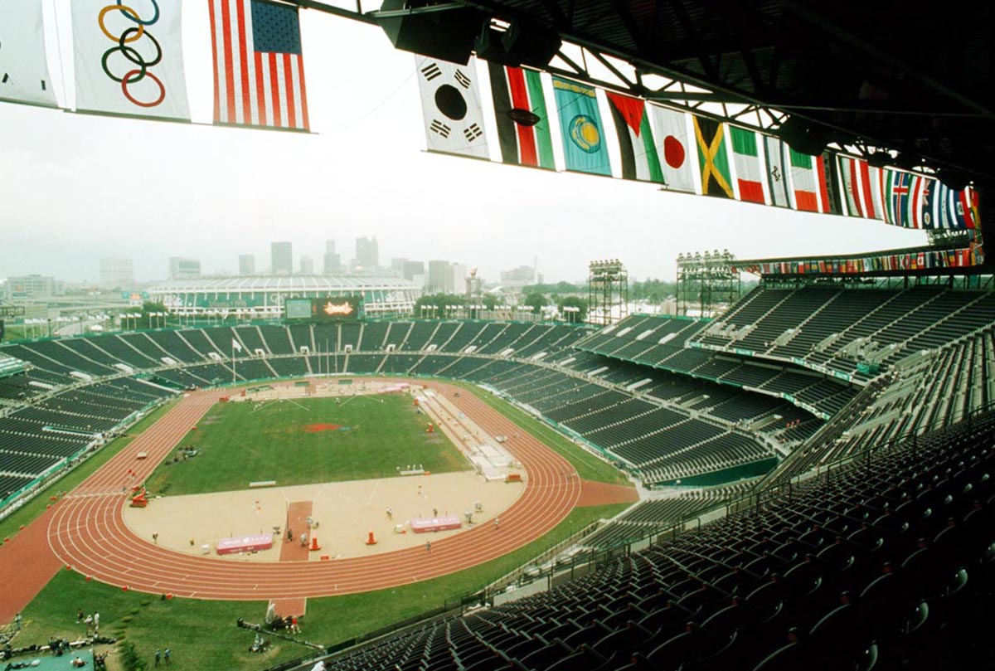
1996 Summer Olympic Games banned single occupant cars in downtown Atlanta
Notes:
Message:
The 1996 Olympics in Atlanta was an opportunity to examine the relationship of traffic, air quality and health.
During the 1996 Summer Olympic Games in Atlanta, the city virtually banned single occupant cars in downtown Atlanta in order to prevent gridlock.
The Journal of the American Medical Association (JAMA) published a study of the ban and its effects, which showed a clear relationship between traffic reduction and reduced incidents of asthma.*
Citation:
*Michael S. Friedman et al. (2001). Impact of Changes in Transportation and Commuting Behaviors During the 1996 Summer Olympic Games in Atlanta on Air Quality and Childhood Asthma. JAMA 285, 897 - 905.
Image:
Provided by http://www.prism.gatech.edu

Slide 15
Results of the ban
Morning traffic – decreased 23%
Peak ozone – decreased 28%
Asthma-related events for kids – decreased 42%
(Friedman, 2001)
Notes:
Message:
The results of the study showed:
Morning rush hour traffic volumes decreased by more than 23%.
This decreased the peak amount of ozone by 28% during the 17 days of the Olympics.
The need for healthcare related to asthma for kids decreased by 42% during the games.*
Reducing auto emissions by encouraging alternative forms of transportation, such as walking and biking can help improve the health of children and adults.
Citation:
*Michael S. Friedman et al, “Impact of Changes in Transportation and Commuting Behaviors During the 1996 Summer Olympic Games in Atlanta on Air Quality and Childhood Asthma,” JAMA, Vol. 285, Feb 2001, pp. 897 - 905.

Slide 16
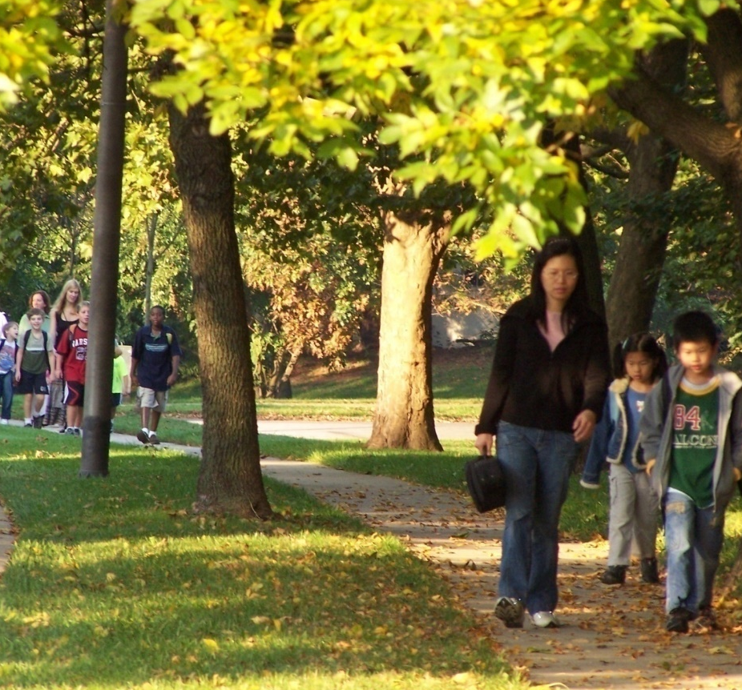
Air quality is measurably better around schools with more walkers and bicyclists
(EPA, 2003)
Notes:
Message:
One of the benefits of SRTS programs is that they help to reduce auto emissions by encouraging alternative forms of transportation, such as walking and biking.
An EPA report found that:
Schools placed in neighborhoods near residential areas with a good street and sidewalk network have more students arriving by bicycle and on foot.
Air quality is measurably better at such locations.*
Note to Instructor:
While the EPA report is from 2003, it is the most recent study of its kind and there's no particular reason why the results may have changed over time.
Citation:
*Travel and Environmental Implications of School Siting. (2003). Washington, D.C.: Environmental Protection Agency, Report No. 231-R-03-004. Available at http://www.epa.gov/smartgrowth/pdf/school_travel.pdf.
Image:
Swansfield Elementary School, Columbia, MD provided by www.iwalktoschool.org

Slide 17
Physical inactivity
Many kids aren’t getting the physical activity they need
Recommended at least 60 minutes daily
(Trust for America’s Health & Robert Wood Johnson Foundation, 2011)
Notes:
Message:
We’ve talked about health as far as air quality is concerned. Another major health factor is the need we all have to be physically active.
Many kids today are not getting the physical activity that they need.
Background:
National recommendations call for children and adolescents to get at least 60 minutes of physical activity per day, most of which should be moderate or vigorous in intensity*.
Citations:
*Trust for America’s Health and Robert Wood Johnson Foundation. F as in Fat: How Obesity Threatens America's Future. Available at http://www.fasinfat.org/facts-trends-in-physical-activity/.
Image:
Purchased by National Center for Safe Routes to School from www.thinkstockphotos.com

Slide 18
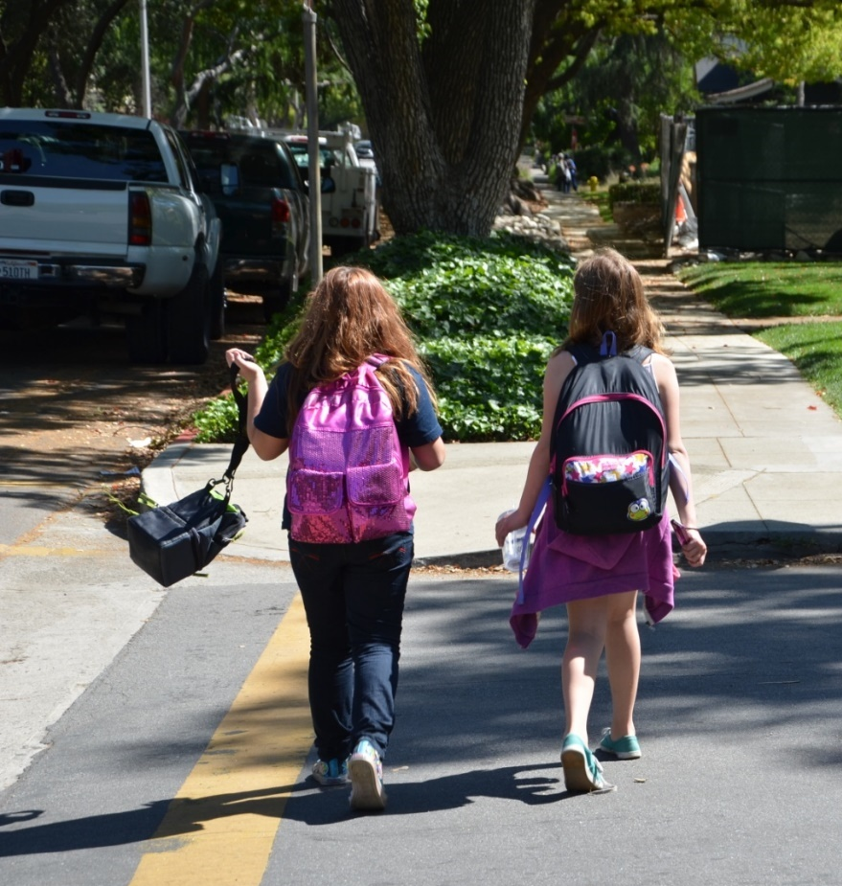
Healthy lifestyle habits, including healthy eating and physical activity, can lower the risk of becoming obese
(CDC, 2013)
Notes:
Message:
Healthy lifestyle habits, including healthy eating and physical activity, can lower the risk of becoming obese and developing related diseases.*
A recent report on childhood obesity shows that six states have childhood obesity rates greater than 20 percent*, and 23 states have childhood obesity rates greater than 15% or more**.
While this is a slight improvement over previous reports, youth overweight and obesity is still a concern.
Citation:
*Centers for Disease Control and Prevention (CDC). (2014, August 13). Childhood obesity facts. Retrieved from http://www.cdc.gov/healthyyouth/obesity/facts.htm
**Trust for America’s Health and Robert Wood Johnson Foundation (2013). F as in Fat: How Obesity Threatens America's Future. Available at http://healthyamericans.org/report/108/.
Image:
Sycamore Elementary, Claremont, CA, provided by Mike Cynecki.

Slide 19
Obese children have an increased risk of…
Heart disease and stroke
Type 2 Diabetes
Low self esteem
Sleep apnea
Several types of cancer
Osteoarthritis
(CDC, 2014)
Notes:
Message:
Research shows that obese children suffer immediate and long-term social, emotional and physical health effects and are more likely to be obese adults.
Citations:
Centers for Disease Control and Prevention (CDC). (2014, August 13). Childhood obesity facts. Retrieved from http://www.cdc.gov/healthyyouth/obesity/facts.htm.

Slide 20
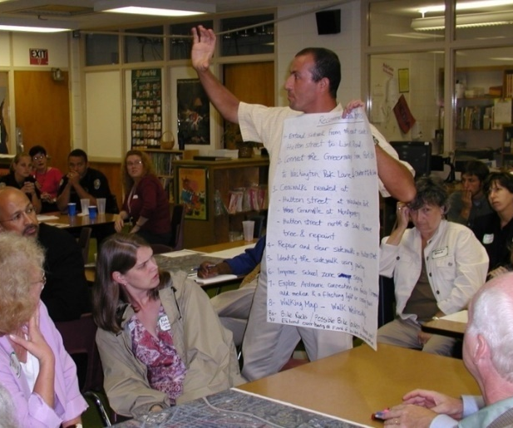
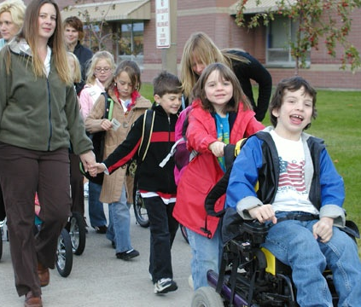
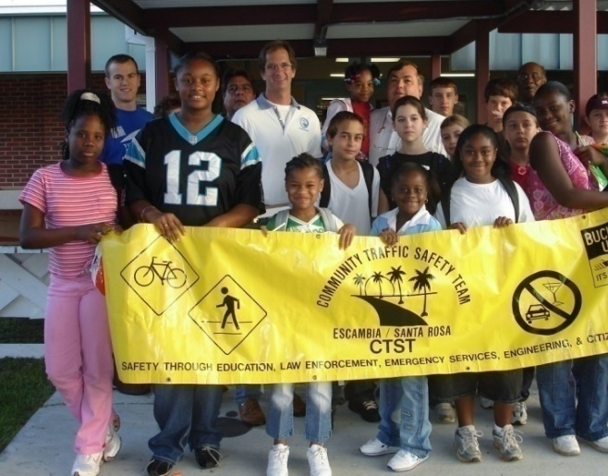
Good news!
Communities are taking action on behalf of children through Safe Routes to School
Notes:
Message:
It is time to focus on the positive. Communities are taking action on behalf of their kids.
Images:
(l) Latham Elementary School, Winston-Salem, NC provided by Mike Cynecki; (c) Emily Dickinson Elementary School in Bozeman, Montana provided through www.iwalktoschool.org, (r) Century Elementary School, Century, FL provided through www.iwalktoschool.org

Slide 21
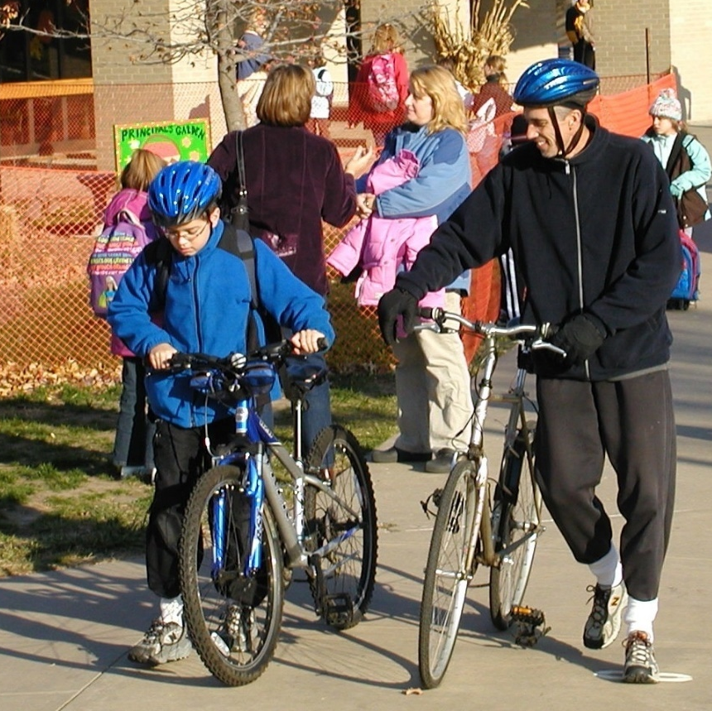
Safe Routes to School programs are part of the solution…
to increase physical activity
to improve unsafe walking conditions
to improve poor air quality by reducing vehicle emissions
Notes:
Message:
Safe Routes to School programs can be part of the solution to making and walking and biking safer, which can in turn be an ideal strategy to increase physical activity among children and improve air quality.
Image:
McAuliffe Elementary, Lenexa, KS provided by Mike Cynecki.

Slide 22
More benefits of SRTS programs
Reduce traffic congestion around schools
Cost savings for schools (reduce need for “hazard” busing)
Increase child’s sense of freedom and responsibility
Teach fundamental safety skills
Strengthen family bonds
Benefit local economy
Provide more transportation options for everyone
Notes:
Message:
There are other potential benefits of SRTS programs:
Reducing congestion around schools.
Saving money for schools (reduce need for hazard busing in which bus service is provided for children who live close to school because the routes are not safe for walking).
Increasing children’s sense of freedom, helping establish lifetime habits, teaching pedestrian skills and bicyclist skills.
Funding construction projects that benefit local economies.
And finally, SRTS programs can increase options for how all people get around their communities.

Slide 23
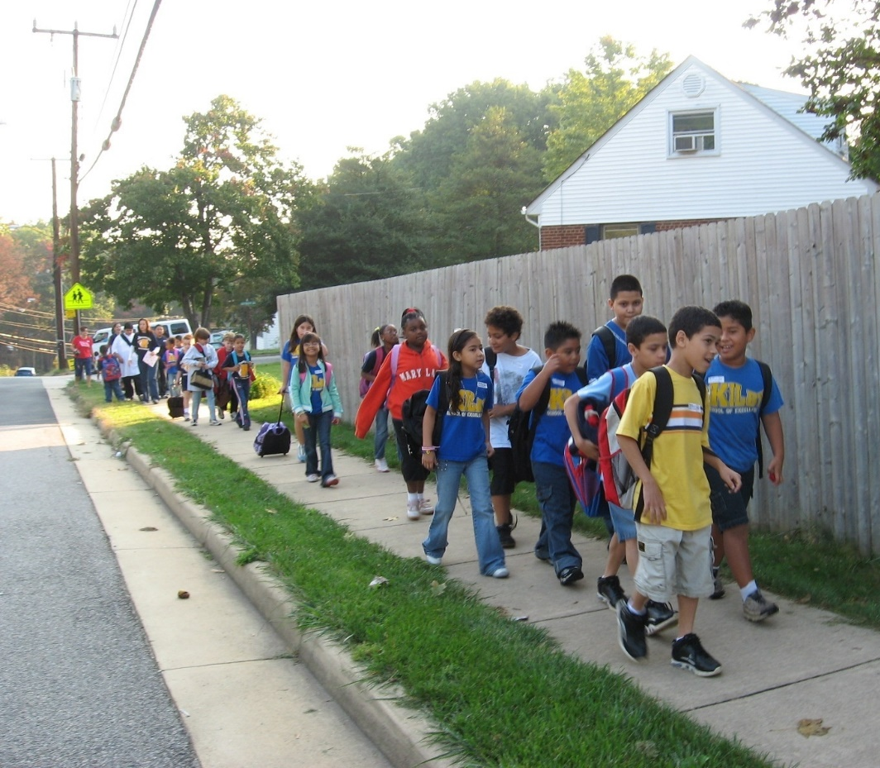
Elements of SRTS programs
Equity
Education
Encouragement
Enforcement
Engineering
Evaluation
Notes:
Message:
Safe Routes to School Programs use the E’s – engineering, education, enforcement, and encouragement.
Evaluation is another element of the SRTS program and is used to identify what changes are happening while the program is underway.
Image:
Kilby Elementary, Woodbridge, VA provided by www.iwalktoschool.org.

Slide 24
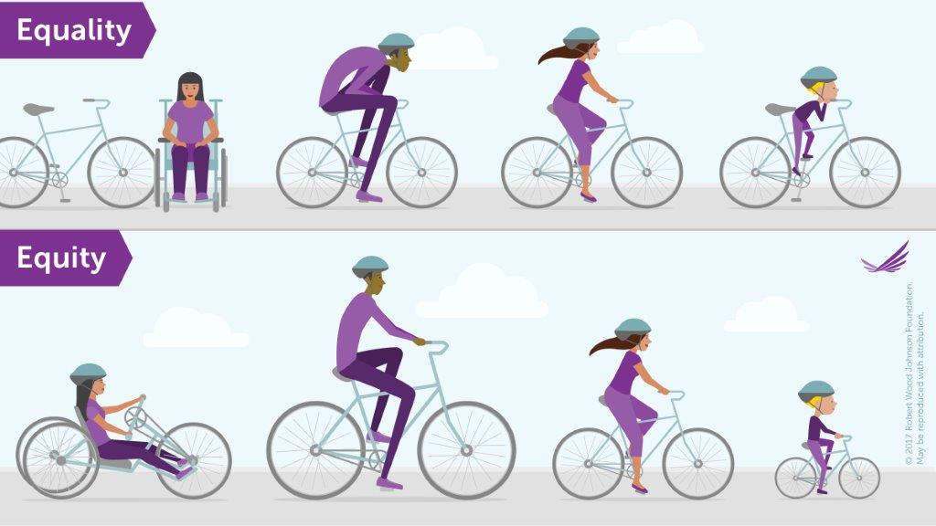
Equity
Notes:
Message:
Minnesota has stark disparities in economic and educational outcomes between Minnesotans of color and white Minnesotans. Investing in safe and convenient places to walk and bike in low-income and communities of color is one part of building a more equitable future for Minnesota.
Children in low-income communities and those who are Latino and African American experience the highest obesity rates of any population group, and bear the burden of the most dangerous conditions for walking and biking – which discourages active transportation and leads to disproportionately high rates of walking and biking injuries.
It is essential to ensure that Safe Routes to School initiatives benefit all demographic groups, with particular attention to ensuring safe, healthy, and fair outcomes for students with disabilities, low-income students, Native American students, students of color, female students, LGBTQ students, students whose families speak a language other than English, homeless students, and other demographic groups.
Image:
Champaign Elementary, Champaign, IL provided by www.iwalktoschool.org.

Slide 25
Education
Teaches safety skills
Creates safety awareness
Fosters life-long safety habits
Includes parents, neighbors and other drivers
Notes:
Message:
Education programs can have long lasting effects.
They teach students safety skills for walking and bicycling and inform parents and other drivers how to drive more safely around pedestrians and bicyclists.
Image:
Champaign Elementary, Champaign, IL provided by www.iwalktoschool.org.

Slide 26
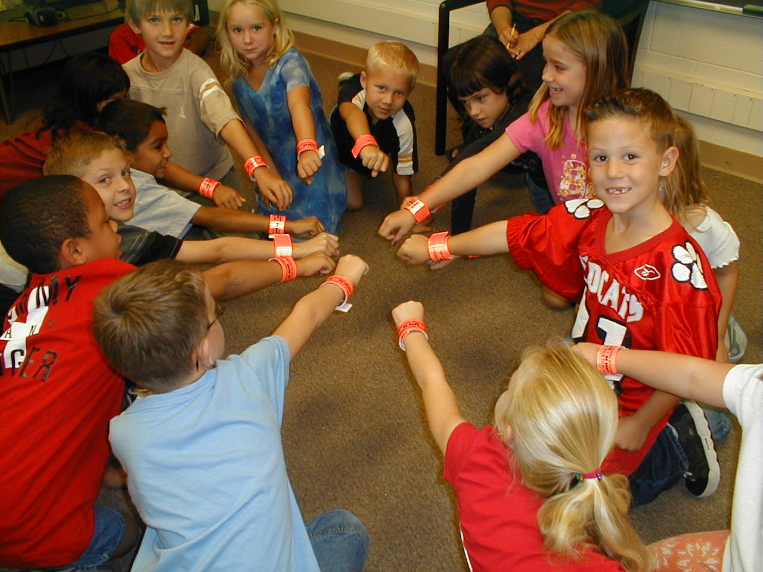
Encouragement
Increases popularity of walking and bicycling
Is an easy way to start SRTS programs
Emphasizes fun of walking and biking
Notes:
Message:
Encouragement strategies such as contests and rewards are an essential part of most Safe Routes to School programs.
They can be the easiest part of a program to start up and the emphasis is on having fun.
Image:
Dunham Elementary School, Tucson, AZ provided by www.iwalktoschool.org.

Slide 27
Enforcement
Increases awareness of pedestrians and bicyclists
Improves driver behavior
Helps children follow traffic rules
Decreases parent perceptions of danger
Notes:
Message:
The primary goals of enforcement programs are to increase awareness of laws protecting children walking and bicycling and improve driver behavior (slower speeds, increased yielding to pedestrians).
The role of the police officer in the SRTS programs goes beyond enforcement and is often included in all phases of the program.
Images:
Barnes Elementary, Burlington, VT provided by Mike Cynecki.

Slide 28
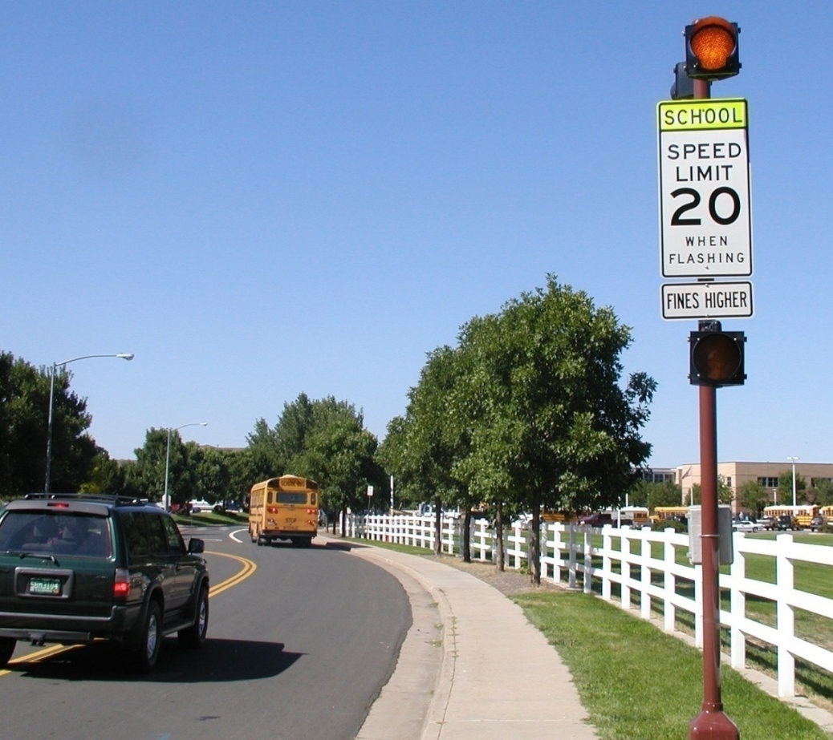
Engineering
Creates safer, more accessible settings for walking and bicycling
Can influence the way people behave
Notes:
Message:
Engineering deals with the built environment and projects that work to create safer places to walk or bike.
Image:
Century Middle School, Thornton, CO provided by Mike Cynecki.

Slide 29
Evaluation
Is the program making a difference?
Notes:
Message:
Evaluation allows programs to track progress over time.
The examples shown here are tools used across the country to collect data about how students get to school and parent attitudes about walking and bicycling. They are available at http://www.saferoutesinfo.org/data-central/data-collection-forms
Images:
National Center for Safe Routes to School, www.saferoutesinfo.org

Slide 30
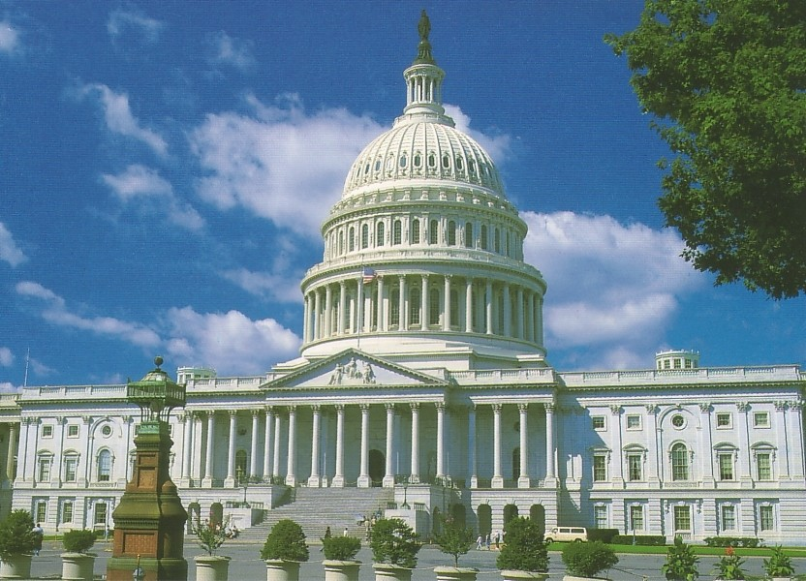
Moving Ahead for Progress in the 21st Century (MAP-21)
Legislation passed in 2012
Established new program: Transportation Alternatives
SRTS activities eligible to compete for funding
State DOTs and MPOs administer funds
Some states have SAFETEA-LU funds remaining
Notes:
Message:
In 2012, Congress passed a new transportation bill: Moving Ahead for Progress in the 21st Century (MAP -21)
Safe Routes to School activities are eligible to compete for funding alongside other programs as part of a program called Transportation Alternatives.
State DOT’s and MPO’s administer the TAP funds
It’s also important to note that some states still have Safe Routes funds to spend from the previous (SAFETEA-LU) legislation.
Citations:
https://www.fhwa.dot.gov/map21/guidance/
Image:
Provided by Allen Matheson © Photohome.com

Slide 31
Minnesota Programs
Minnesota Safe Routes to School Coordinator
Dave Cowan
dave.cowan@state.mn.us
651-366-4180

Slide 32
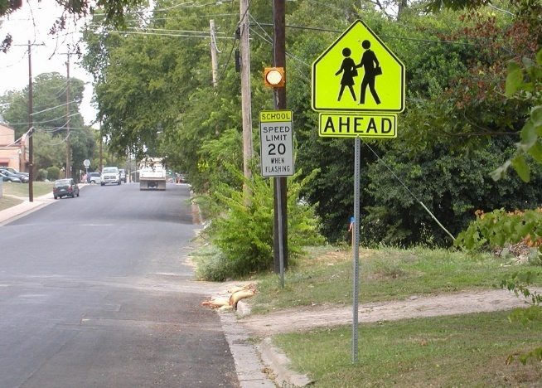
Safe Routes to School Goals
Where it’s safe, get children walking and biking
Where it’s not safe, make changes
Notes:
Message:
In summary, the goals of SRTS programs are to get more kids walking and bicycling where it is safe and to fix conditions where it is not safe.
The opportunity to bike and walk to school offers a solution to an array of concerns about traffic safety, traffic congestion, transportation costs, air pollution and lack of physical activity.
Image:
(t) Scituate, MA provided by Mark Fenton; (b) Metz Elementary, Austin, TX provided by Mike Cynecki.

Slide 33
Notes:
Summary:
The Minnesota Safe Routes to School resource center has tools to help communities plan and implement SRTS programs.
Thank you.

