Slide 1
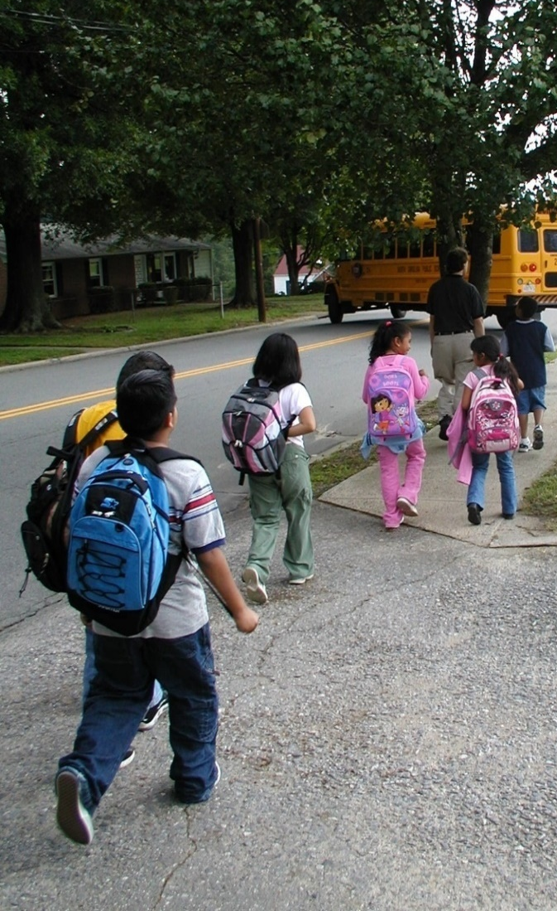
Bus Stop & Walk
Enabling more students to enjoy and benefit from walking to school
Notes:
To the presenter:
This presentation provides a brief overview of Bus Stop and Walks, why they are important, and tips for starting one at your school.
Each slide contains speaker notes with key points and citations are provided where relevant. Where appropriate, image location information has been placed on the slide for the audience to see.
Please go to www.mnsaferoutestoschool.org for further information on any of the topics mentioned in this presentation.
Learning objectives:
Upon completion of this presentation, listeners will:
Understand the definition of a bus stop and walk.
Understand the benefits.
Be familiar with the basic steps to set up a able to describe elements of Safe Routes to School programs.
Image:
Latham Elementary School, Winston-Salem, NC provided by Mike Cynecki.

Slide 2
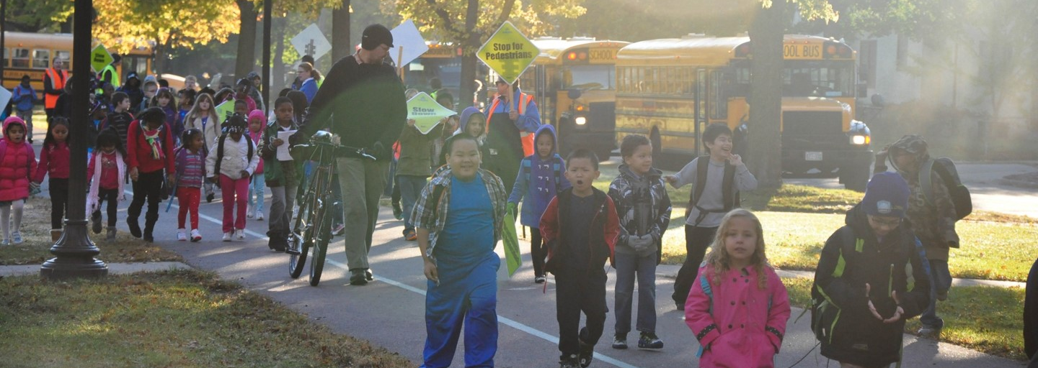
What is a Bus Stop & Walk?
A Bus Stop & Walk (BSW) is when buses drop students at a predetermined location away from school and they walk as a group the rest of the way.
Notes:
Message:
A Bus Stop & Walk occurs when buses drop students at a predetermined location approximately 0.5 miles from school.
School staff and volunteers meet students at the drop-off site and accompany them on the 10-12-minute walk along a designated route to school.
Other names for a BSW may include “alternate” or “remote drop-off,” but these terms often have negative connotations.
The term BSW emphasizes both travel modes – riding the bus and walking to school.
Image:
Loring Elementary School, Minneapolis, MN

Slide 3
BSW ≠ Walking School Bus
Bus Stop & Walk
Buses drop students about 0.5 miles from school
Students are met by school staff and volunteers
Everyone walks the rest of the way to school
Walking School Bus
A group of students and parents who live within walking distance of school
Follows a set walking route and picks up additional students along the way
Notes:
Message:
A BSW is different from a “walking school bus.”
A “walking school bus” is formed by a group of students and parents who live within walking distance of school.
The “walking school bus” is a name for the group, which follows a set walking route and picks up additional students along the way.
For a Bus Stop and Walk, students who usually ride the bus all walk together from a single location. Students that usually walk to school are encouraged to join the group at the drop-off location or along the route to school.
0.5 miles is a good distance for a BSW route. A half-mile is close enough to be within a school’s walk zone, but long enough to provide students with 10-15 minutes of physical activity, which research has shown to improve concentration.
Image:

Slide 4
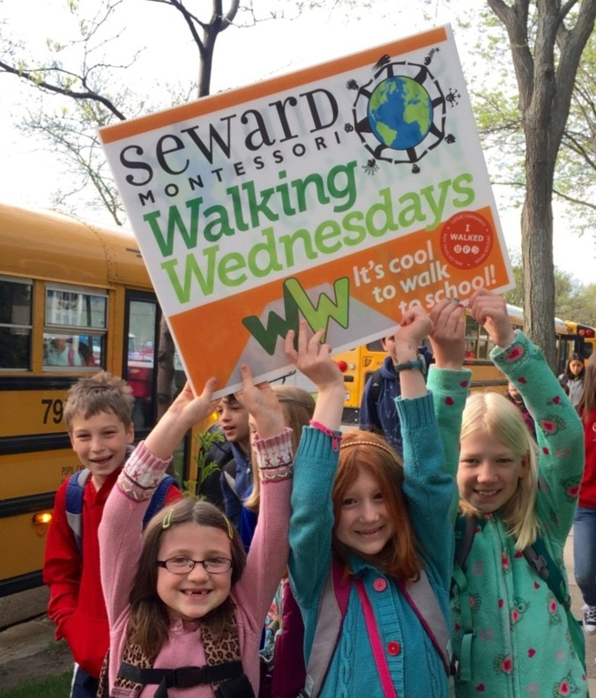
Why Start a Bus Stop & Walk?
Schools start BSW to:
Improve physical and mental health
Increase academic performance
Build community
Notes:
Message:
Research shows a positive correlation between physical activity and academic achievement.
The walk to school helps students meet the goal of 60 minutes of daily physical activity.
Students that walk to school have increased environmental awareness and learn lifelong pedestrian safety skills.
Bus Stop & Walks provide leadership opportunities for older students trained to help younger students on the way to school.
Bus Stop & Walks build community through positive exposure for the school in the neighborhood.
Image:
Walking Wednesdays at Seward Montessori; Minneapolis Public Schools

Slide 5
Case Study: Minneapolis Public Schools
The BSW has been good for our school.
On the BSW day, children arrive more alert and ready to learn.
100% agree or strongly agree
Notes:
Message:
Minneapolis Public Schools Safe Routes to School staff support Bus Stop and Walks at several elementary schools in the district. The oldest programs began at Northrop Elementary and Loring Elementary in 2012 and 2013, respectively.
A short survey about the Bus Stop & Walk was given to school staff in May/June of 2016 that allows MPS SRTS staff to compare observations of students on BSW days to research about the positive impact of walking and biking to school.
103 staff from these schools took the short, anonymous survey. As you can see, staff are overwhelming positive about the bus stop and walk and its impact on children and the school day.
Image:

Slide 6
Case Study: Minneapolis Public Schools
On the days of the bus stop and walk children seem (check all that apply)
94% of descriptors chosen were positive
Notes:
Message:
Minneapolis Public Schools Safe Routes to School staff support Bus Stop and Walks at several elementary schools in the district. The oldest programs began at Northrop Elementary and Loring Elementary in 2012 and 2013, respectively.
A short survey about the Bus Stop & Walk was given to school staff in May/June of 2016 that allows MPS SRTS staff to compare observations of students on BSW days to research about the positive impact of walking and biking to school.
103 staff from these schools took the short, anonymous survey. As you can see, staff are overwhelming positive about the bus stop and walk and its impact on children and the school day.
Image:

Slide 7
Addressing Common Concerns
Liability
Safety
Weather
Meet with risk management early on
Teach pedestrian safety skills in advance
Most BSW run fall and spring only
Train staff and volunteers
Reinforce pedestrian safety along the route
Have a plan in place for last minute cancellations
Notes:
Message: Customize this slide as needed for your audience.
The most common concerns related to starting a BSW program are liability, safety and weather.
Liability concerns can be addressed by working with the school district’s risk management department early on to explain the program and determine the steps needed to secure parental permission. Taking care when identifying the route and training school staff and volunteers also shows that due care has been taken to address risk.
One way to address safety concerns is teaching pedestrian safety skills to students before the first BSW. These skills should be reinforced and practiced along the route.
Weather is only an issue if you don’t plan for it. Most BSW programs take a break over the winter to avoid the worst weather and all programs should address procedures for last minute cancellations as part of the planning process.
See the BSW Planning Checklist and Organizer’s Guide to Bus Stop and Walks for more information.
Image:

Slide 8
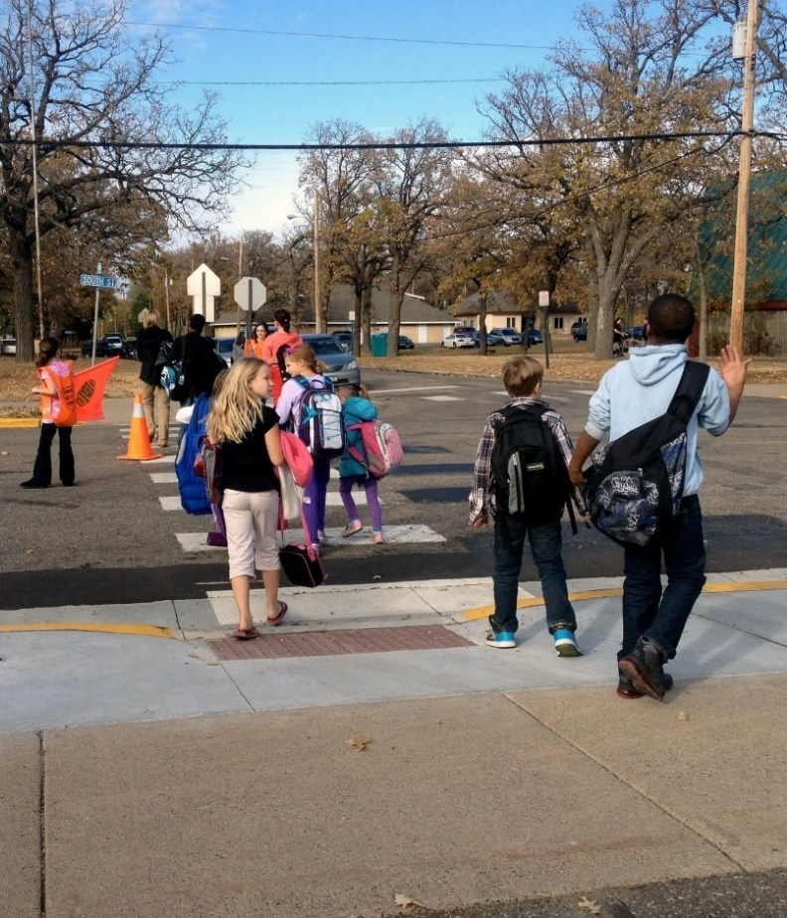
Basic Steps to Start a BSW
Identify a BSW Leader
Start with a one-time event
Determine strategies to involve students of all abilities
Brand it!
Send letters to parents, neighbors and bus drivers
Debrief after the event and make adjustments as needed
Have fun!
Notes:
Message: Customize this slide as needed for your audience.
Having a main point of contact within the school and principal support are the keys to a successful BSW.
Don’t be intimidated by the idea of setting up a BSW for the whole year – start with one day, like Walk to School Day and go from there.
Build excitement by naming the BSW after something unique to your school.
Don’t forget to have fun! Things may not always go exactly according to plan, but the more students benefiting from physical activity before starts, the more smoothly the rest of the school day will go.
See the BSW Planning Checklist for more details.
Image:
Lincoln Elementary School; Minneapolis Public Schools

Slide 9
Additional Resources
Organizer’s Guide to Bus Stop and Walks
BSW One-Pager
BSW Planning Checklist
Crossing Guard Training Resources
Mapping Guide
Sample letters for parents, bus drivers, volunteers and neighbors
Pedestrian Safety Education Resources
BSW Sample Survey Questions
Visit mnsaferoutestoschool.org to view and download these resources!
Notes:
Message:
All of these resources are available for download on the Minnesota Safe Routes to School Resource Center website.

